Slide 1
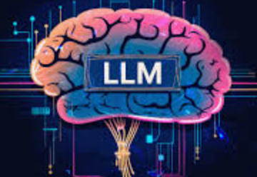

PPT Last Updated on : June 01, 2024 5:00 PM CST

Slide 2
Trainer:
Srini Pusuluri
Linkedin: https://www.linkedin.com/in/pusulurisrinivasa/
MTech IIT India
25yr IT Exp
Fmr Scientist, AT&T,IBM, Google, ElasticSearch
Trained 400 in Salesforce,CPQ
Copyright - Pusuluri Foundation/Next Gen Cloud LLC 2024

Slide 3
Prerequisites External References
(click to open each doc in link and READ)
What is a computer
Data Structures
Programming languages fundamentals
Object oriented Programming concepts in Python
Compare python with java/JS
Compare 6 programming lan -research paper

Slide 4
Prerequisites Hardware/Software/Cloud
Windows or Mac Laptop
Python Package
Python online Editor (only for initial days)
Python IDE Vscode or Jupiter IDE
Open AI account (Free or Paid)
ChatGPT, MS Copilot, Meta AI, Google AI (FREE)
Google Colab (Learning& Production)
Gitlab or GitHub account (store code)
Salesforce CRM (dev only for CRM apps)
JRE as needed

Slide 5
Purpose of this course is to Teach how Gen AI LLM works and also show How Python as a Programming language is being used to develop such advanced AI LLM applications
Notes:
https://en.wikipedia.org/wiki/Python_(programming_language)
https://www.w3schools.com/python/default.asp

Slide 6
I will also pick top max 5 performers to work with me in real AI LLM projects - Again no Payments involved neither i pay nor you pay!!
Notes:
https://en.wikipedia.org/wiki/Python_(programming_language)
https://www.w3schools.com/python/default.asp

Slide 7
Python & AI ( not just python alone)
Why Python is needed
What is happening in AI
What is LLM, AI,ML, Neural Networks
How is future of AI shaping
What kind of career one can built
Direction on various python projects
Direction on LLM projects
I will pick 5 assistants and work with our own product
No pay Involved - Neither you pay nor i pay
What course covers
Notes:
https://en.wikipedia.org/wiki/Python_(programming_language)
https://www.w3schools.com/python/default.asp

Slide 8
This is not about just python
NO job support - i do not have any jobs
I do not deep dive into everything
I do not teach Fundamentals of computers
Not a paid course
Not ideal for pre-high school students
Not ideal unless you are ready to code
What course DO NOT cover
Notes:
https://en.wikipedia.org/wiki/Python_(programming_language)
https://www.w3schools.com/python/default.asp

Slide 9
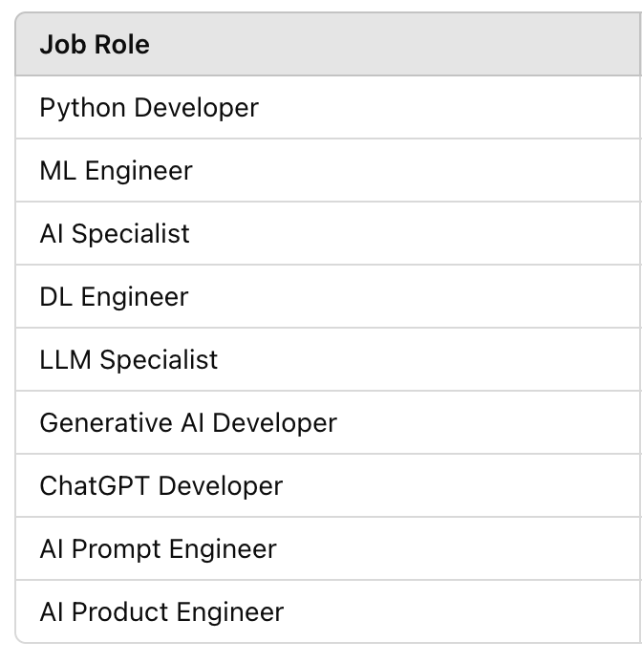
Job Market:
Experienced jobs AI engineer or basic jobs like Prompt
Overall AI knowledge
Domain knowledge
Healthcare
Finance
Retail etc
Business Analysis
Software Dev
Product Engineering

Slide 10
High Level Topics Covered
Python
Gen AI Concepts
Neural Networks
ML Algorithms
OpenAI API framework
LLM Architecture
Prompt Engineering
Gen AI LLM Projects

Slide 11
Computer Revolutions - AI Next steps
Main frame 1950-1970
Personal computer 1970-Present
Client-server 1980-1990
Web based 1990-present
Cloud/Mobile 2000-Present
AI - 2010 …and 2020 growing fast

Slide 12
What is
AI (Artificial Intelligence)
ML (Machine Learning)
DL (Deep Learning)
LLM (Large Language Model)
Gen AI (Generative AI)

Slide 13
Artificial Intelligence
Artificial intelligence (AI), in its broadest sense, is intelligence exhibited by machines, particularly computer systems. It is a field of research in computer science that develops and studies methods and software that enable machines to perceive their environment and uses learning and intelligence to take actions that maximize their chances of achieving defined goals.

Slide 14
Machine Learning
Machine learning (ML) is a field of study in artificial intelligence concerned with the development and study of statistical algorithms that can learn from data and generalize to unseen data, and thus perform tasks without explicit instructions.

Slide 15
Deep Learning
Deep learning (DL) is the subset of machine learning methods based on neural networks with representation learning. The adjective "deep" refers to the use of multiple layers in the network. Methods used can be either supervised, semi-supervised or unsupervised

Slide 16
Large Language Model
A large language model (LLM) is a language model notable for its ability to achieve general-purpose language understanding and generation. LLMs acquire these abilities by learning statistical relationships from text documents during a computationally intensive self-supervised and semi-supervised training process.^{[1]} LLMs can be used for text generation, a form of generative AI, by taking an input text and repeatedly predicting the next token or word.

Slide 17
Generative AI
Generative artificial intelligence (Gen AI) is artificial intelligence capable of generating text, images, videos, or other data using generative models, often in response to prompts. Generative AI models learn the patterns and structure of their input training data and then generate new data/response that has similar characteristics.

Slide 18
DL
AI
LLM/Gen AI
ML
LLM
Generative AI uses LLM based upon DL algorithms which is subset of ML which is further a subset of overall AI

Slide 19
Category | Examples
AI | Expert Systems, Robotics, Natural Language Processing (NLP), Computer Vision, Autonomous Vehicles
ML | Recommendation Systems, Fraud Detection, Predictive Maintenance, Email Spam Filtering, Customer Churn Prediction
DL | Image Classification, Speech Recognition, Language Translation, Generative Adversarial Networks (GANs), Self-Driving Cars
LLM | GPT-3, BERT, T5, RoBERTa, XLNet
Gen AI | DALL-E, ChatGPT, DeepArt, Jukedeck, Runway ML

Slide 20
AI Challenges
Speed
Cost
Accuracy
Security
Ethics.

Slide 21
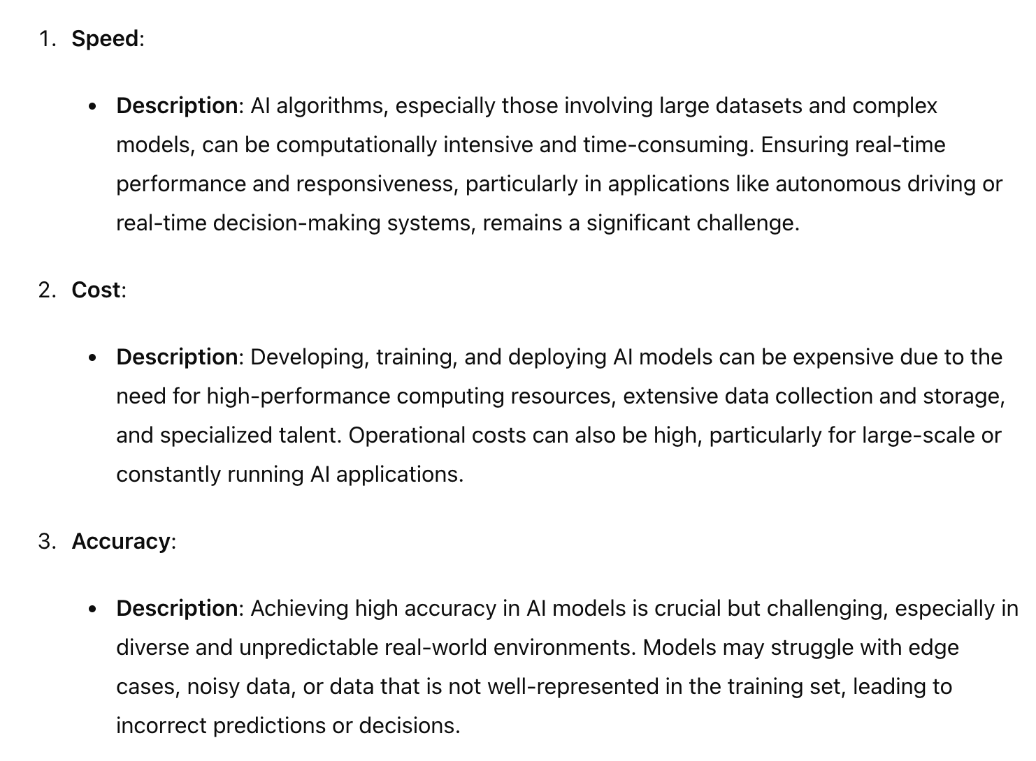
AI Challenges

Slide 22
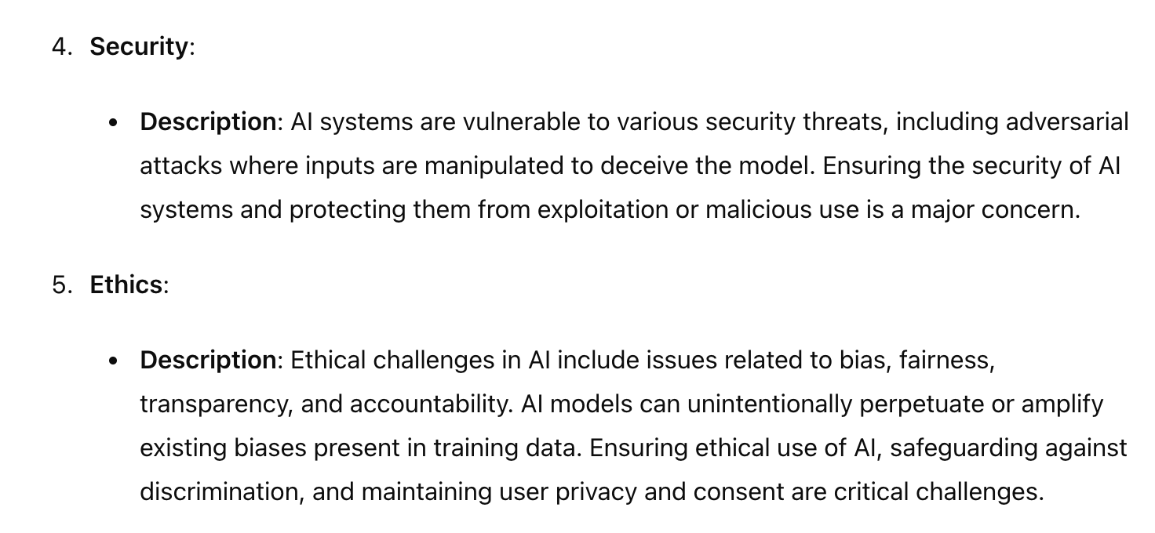
AI Challenges

Slide 23
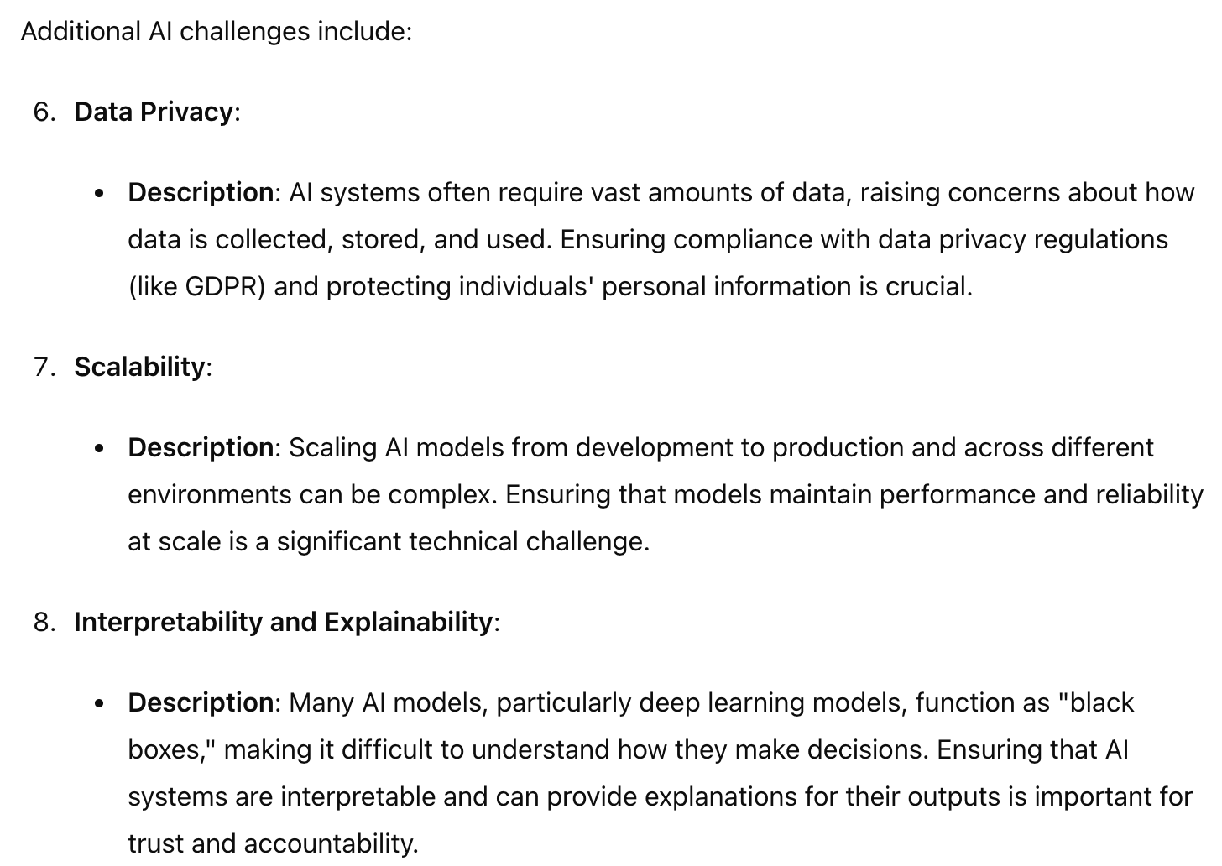
AI Challenges

Slide 24
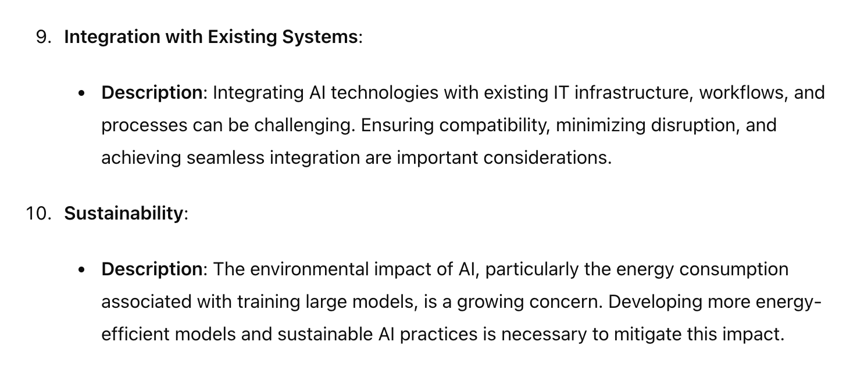
AI Challenges

Slide 25
Sample LLM BOT Code
This is an example how - A simple 100 lines code can do so much magic - At this stage do not worry about what the code is-just think about we can develop such applications
Notes:
https://python.langchain.com/v0.1/docs/integrations/llms/

Slide 26

Chat with PDF demo
This demo explains an use cases where an LLm used private PDF data and by using LLM RAG model, customers can chat with contents in PDF through conversational BOT. using Python code this is developed. Thai shows power of Python in Gen AI LLM
Chat with PDF demo

Slide 27

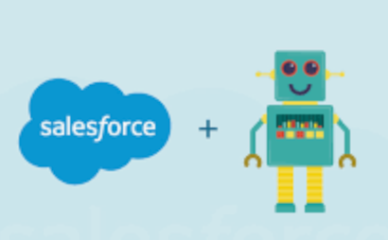


Architecture
Is patient at Heart risk ?
Python
Not really but …
Application requests goes to RAG DB and sends details to LLM and LLM responds to chat BOT - Python is involved

Slide 28
import streamlit as st
from dotenv import load_dotenv
from PyPDF2 import PdfReader
from langchain.text_splitter import CharacterTextSplitter
from langchain.embeddings import OpenAIEmbeddings, HuggingFaceInstructEmbeddings
from langchain.vectorstores import FAISS
from langchain.chat_models import ChatOpenAI
from langchain.memory import ConversationBufferMemory
from langchain.chains import ConversationalRetrievalChain
from htmlTemplates import css, bot_template, user_template
from langchain.llms import HuggingFaceHub
Import Libraries
Notes:
https://python.langchain.com/v0.1/docs/integrations/llms/

Slide 29
def get_pdf_text(pdf_docs):
text = ""
for pdf in pdf_docs:
pdf_reader = PdfReader(pdf)
for page in pdf_reader.pages:
text += page.extract_text()
return text
def get_text_chunks(text):
text_splitter = CharacterTextSplitter(
separator="\n",
chunk_size=1000,
chunk_overlap=200,
length_function=len
)
chunks = text_splitter.split_text(text)
return chunks
def get_vectorstore(text_chunks):
# import pdb;pdb.set_trace()
embeddings = OpenAIEmbeddings()
# embeddings = HuggingFaceInstructEmbeddings(model_name="hkunlp/instructor-xl")
vectorstore = FAISS.from_texts(texts=text_chunks, embedding=embeddings)
return vectorstore
def get_conversation_chain(vectorstore):
llm = ChatOpenAI()
# llm = HuggingFaceHub(repo_id="google/flan-t5-xxl", model_kwargs={"temperature":0.5, "max_length":512})
memory = ConversationBufferMemory(
memory_key='chat_history', return_messages=True)
conversation_chain = ConversationalRetrievalChain.from_llm(
llm=llm,
retriever=vectorstore.as_retriever(),
memory=memory
)
return conversation_chain
def handle_userinput(user_question):
response = st.session_state.conversation({'question': user_question})
st.session_state.chat_history = response['chat_history']
for i, message in enumerate(st.session_state.chat_history):
if i % 2 == 0:
st.write(user_template.replace(
"{{MSG}}", message.content), unsafe_allow_html=True)
else:
st.write(bot_template.replace(
"{{MSG}}", message.content), unsafe_allow_html=True)
def main():
load_dotenv()
st.set_page_config(page_title="Chat with multiple PDFs",
page_icon=":books:")
st.write(css, unsafe_allow_html=True)
if "conversation" not in st.session_state:
st.session_state.conversation = None
if "chat_history" not in st.session_state:
st.session_state.chat_history = None
st.header("Chat with multiple PDFs :books:")
user_question = st.text_input("Ask a question about your documents:")
if user_question:
handle_userinput(user_question)
with st.sidebar:
st.subheader("Your documents")
pdf_docs = st.file_uploader(
"Upload your PDFs here and click on 'Process'", accept_multiple_files=True)
if st.button("Process"):
with st.spinner("Processing"):
# get pdf text
raw_text = get_pdf_text(pdf_docs)
# get the text chunks
text_chunks = get_text_chunks(raw_text)
# create vector store
vectorstore = get_vectorstore(text_chunks)
# create conversation chain
st.session_state.conversation = get_conversation_chain(
vectorstore)
Do not worry if you do not understand full code
Functions
Notes:
https://python.langchain.com/v0.1/docs/integrations/llms/
https://towardsdatascience.com/everything-you-need-to-know-about-activation-functions-in-deep-learning-models-84ba9f82c253

Slide 30
def handle_userinput(user_question):
response = st.session_state.conversation({'question': user_question})
st.session_state.chat_history = response['chat_history']
for i, message in enumerate(st.session_state.chat_history):
if i % 2 == 0:
st.write(user_template.replace(
"{{MSG}}", message.content), unsafe_allow_html=True)
else:
st.write(bot_template.replace(
"{{MSG}}", message.content), unsafe_allow_html=True)
def main():
load_dotenv()
st.set_page_config(page_title="Chat with multiple PDFs",
page_icon=":books:")
st.write(css, unsafe_allow_html=True)
if "conversation" not in st.session_state:
st.session_state.conversation = None
if "chat_history" not in st.session_state:
st.session_state.chat_history = None
st.header("Chat with multiple PDFs :books:")
user_question = st.text_input("Ask a question about your documents:")
if user_question:
handle_userinput(user_question)
with st.sidebar:
st.subheader("Your documents")
pdf_docs = st.file_uploader(
"Upload your PDFs here and click on 'Process'", accept_multiple_files=True)
if st.button("Process"):
with st.spinner("Processing"):
# get pdf text
raw_text = get_pdf_text(pdf_docs)
# get the text chunks
text_chunks = get_text_chunks(raw_text)
# create vector store
vectorstore = get_vectorstore(text_chunks)
# create conversation chain
st.session_state.conversation = get_conversation_chain(
vectorstore)
Notes:
https://python.langchain.com/v0.1/docs/integrations/llms/
https://towardsdatascience.com/everything-you-need-to-know-about-activation-functions-in-deep-learning-models-84ba9f82c253

Slide 31
Generative Use Case (Medical Field)
Generative AI Use Case in Medical Field: Predicting Heart Disease Risk and Providing Preventative Measures
Use Case Description
Objective: To develop an AI-powered medical assistant that uses a large language model (LLM) trained with medical data to predict a patient's risk of developing heart disease and provide personalized preventative measures based on the patient's medical history.

Slide 32
Generative Use Case (Use Case)
Use Case:
Patient Data Collection: Gather past medical history and lifestyle data of the patient.
Risk Assessment: Use an instruction-trained LLM to analyze the collected data and predict the risk of heart disease.
Personalized Recommendations: Provide customized preventive measures to mitigate the identified risks.

Slide 33
Generative Use Case (Solution)
Components:
Pre-trained Base LLM: An open-source language model such as GPT-3 or GPT-4.
Instruction-Tuned Model: A model fine-tuned with medical data and instructions to provide accurate medical advice.
Retrieval-Augmented Generation (RAG): Enhances the LLM by retrieving relevant information from a vector database for personalized and context-specific responses.
Vector Database: An open-source vector database like FAISS or Milvus to store and retrieve patient-specific data efficiently.
Data Pipeline: Collects and preprocesses patient data for analysis.
User Interface: A web or mobile application for patient interaction.

Slide 34
Other use cases
1. Finance
Use Case: Fraud Detection and Prevention
Description: Develop an AI system that analyzes transaction patterns and flags suspicious activities in real-time to prevent fraudulent transactions and reduce financial losses.
2. Healthcare
Use Case: Personalized Treatment Recommendations
Description: Use an LLM to analyze patient records and genetic data to suggest personalized treatment plans and medication regimens tailored to individual patient needs.
3. Retail
Use Case: Customer Sentiment Analysis
Description: Implement a system to analyze customer reviews and feedback across multiple platforms, providing insights into customer sentiment and helping businesses improve products and services.
4. Manufacturing
Use Case: Predictive Maintenance
Description: Use AI to monitor machinery data and predict potential failures before they occur, allowing for timely maintenance and reducing downtime.

Slide 35
Other use cases
5. Education
Use Case: Intelligent Tutoring Systems
Description: Create an AI tutor that provides personalized learning experiences, adapts to student progress, and offers targeted help in areas where students struggle.
6. Security
Use Case: Threat Intelligence Analysis
Description: Develop a system that gathers and analyzes cybersecurity threat data to provide real-time alerts and insights, helping organizations mitigate potential security breaches.
7. Transportation
Use Case: Route Optimization for Logistics
Description: Implement AI to optimize delivery routes for logistics companies, reducing travel time, fuel consumption, and operational costs.
8. Hospitality
Use Case: Personalized Travel Recommendations
Description: Use AI to analyze customer preferences and travel history to provide personalized travel itineraries and accommodation suggestions.

Slide 36
Other use cases
9. Legal
Use Case: Contract Analysis and Management
Description: Develop a system that automates the analysis of legal contracts, identifying key terms and potential risks, and helping in contract management and compliance.
10. Energy
Use Case: Energy Consumption Optimization
Description: Use AI to analyze energy usage patterns and suggest optimizations for reducing energy consumption in homes and businesses, leading to cost savings and reduced environmental impact.
11. Agriculture
Use Case: Crop Disease Detection
Description: Implement an AI system that uses image recognition to analyze photos of crops and detect early signs of diseases, enabling farmers to take timely actions to protect their yields.
.
12. Real Estate
Use Case: Property Valuation and Market Analysis
Description: Develop an AI tool that analyzes real estate market trends, historical sales data, and property features to provide accurate property valuations and market insights for buyers, sellers, and investors.

Slide 37
Use cases in CRM
1. Automated Customer Support
Description: Develop a chatbot powered by generative AI to handle customer inquiries related to bill payments and fund transfers, providing quick and accurate responses 24/7.
2. Interactive Voice Response (IVR) System
Description: Implement an AI-driven IVR system to guide customers through their queries and transactions over the phone, offering personalized assistance based on the customer's account history.
3. Sentiment Analysis on Customer Interactions
Description: Use AI to analyze the sentiment of customer interactions across emails, chat support, and social media, helping identify dissatisfied customers and improving service quality.
.
4. Proactive Service Recommendations
Description: Create an AI system that analyzes transaction history and usage patterns to recommend personalized financial products or services, such as bill payment plans or fund transfer options.

Slide 38
Use cases in CRM
5. Fraud Detection in Real-time
Description: Deploy an AI system to monitor fund transfer transactions in real-time, detecting and flagging suspicious activities to prevent fraud.
6. Customer Feedback Analysis
Description: Use AI to analyze feedback from surveys and follow-up interactions, extracting insights to improve services related to bill payments and fund transfers.
7. Personalized Product Recommendations
Description: Implement an AI tool that suggests relevant financial products or services to customers based on their past bill payments and transfer behaviors, enhancing the customer experience.
8. Automated Survey Follow-up
Description: Develop an AI-driven system to automatically follow up with customers after transactions or support interactions, gathering feedback and providing additional support if needed.

Slide 39
Python Loading!!

Slide 40
Invented in 1980
Invented by Guido van Rossum
Simple & Easy to understand/Learn
Object Oriented
Gaining more popularity
Corporate supported (Google..)
Increased speed & security
Widespread community & libraries
AI/ML/LLM libraries widely available
Python must for AI jobs
Python is for: Application, general, web, scripting, artificial intelligence, scientific computing
Python
Background
Notes:
https://en.wikipedia.org/wiki/Python_(programming_language)
https://www.w3schools.com/python/default.asp

Slide 41
Python official guide
Python University Course
O’reilly Python Ultimate Guide
Python downloads&installs
Python online editor
Python Projects to Try
Python ML Projects to Try
Python
Resources
Notes:
https://en.wikipedia.org/wiki/Python_(programming_language)
https://www.w3schools.com/python/default.asp

Slide 42
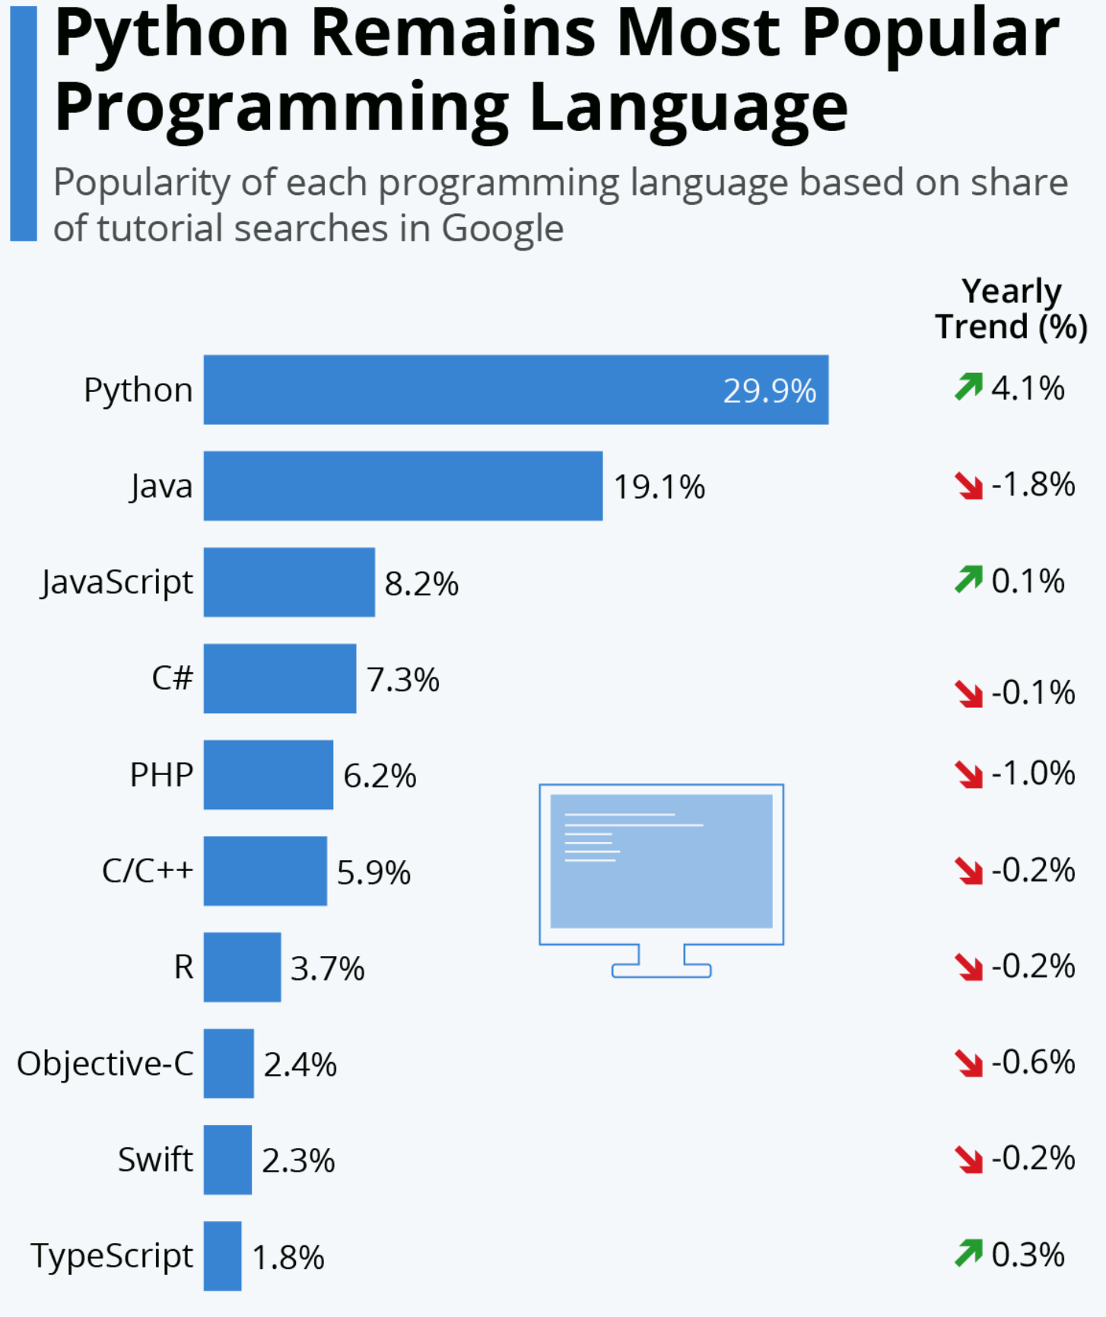

Slide 43
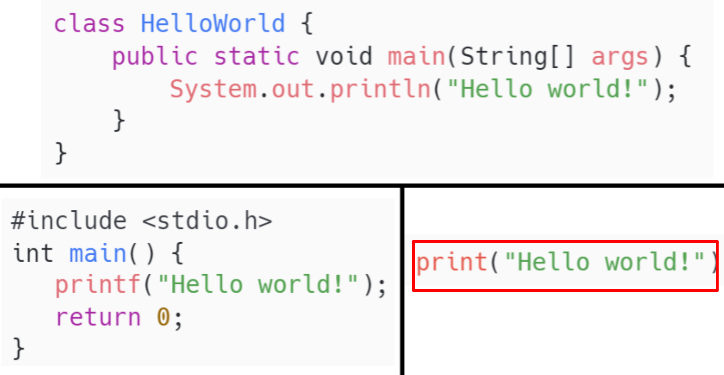
SIMPLE Syntax

Slide 44
A Program lang needs
Basic Data types ( byte,string, in,float) - handle data
Arithmetics - To do math on data
Collections (data structures) - To hold data
Objects - To combine data with operations
Control statements - To communicate between objects
File handling - To communicate external files
Error handling, Reuse libraries, Debugging, Deploy etc

Slide 45
Python Syllabus
Standard types and Variables (float,string,text)
Data structures(array,list,tuple,dictionary,set)
Control flows(if,for,while,pass,break,continue,match)
Exceptions(try,except,raise)
Functions,Modules & Packages
File I/O
Class (OOPs,inheritance,object,attributes,method,init)
Logging,Template,multiThread
Environment installs (Virtual),IDE
Libraries-Next slide
Notes:
https://docs.python.org/3/tutorial/introduction.html#numbers
https://assets.openstax.org/oscms-prodcms/media/documents/Introduction_to_Python_Programming_-_WEB.pdf

Slide 46
Inbuilt (math,string etc)
Pandas (data manipulation)
Numpy (ml)
Matplotlib (plots)
Scipi (statistics)
Scikit-learn/TensorFlow/Pytorch/Keras (ML)
Flask/Django/Streamlit (web UI)
Openai (LLM)
Langchain (Framework)
Huggingface/Transformers/datasets (Training datasets)
Pinecone/chromedb/elasticsearch (VecorDB)
Python Popular Libraries
Notes:
https://www.mygreatlearning.com/blog/open-source-python-libraries/
https://blog.finxter.com/top-5-llm-python-libraries/
https://python.langchain.com/v0.1/docs/integrations/platforms/huggingface/

Slide 47
Python Basic Data Types
Text Type: | str
Numeric Types: | int, float, complex
Sequence Types: | list, tuple, range
Mapping Type: | dict
Set Types: | set, frozenset
Boolean Type: | bool
Binary Types: | bytes, bytearray, memoryview
None Type: | NoneType

Slide 48
Python Basic data types and Variables
Example | Data Type
x = "Hello World" | str
x = 20 | int
x = 20.5 | float
x = 1j | complex
x = ["apple", "banana", "cherry"] | list
x = ("apple", "banana", "cherry") | tuple
x = range(6) | range
x = {"name" : "John", "age" : 36} | dict
x = {"apple", "banana", "cherry"} | set
x = frozenset({"apple", "banana", "cherry"}) | frozenset
x = True | bool
x = b"Hello" | bytes
x = bytearray(5) | bytearray
x = memoryview(bytes(5)) | memoryview
x = None | NoneType

Slide 49
Python Collection
There are four collection data types in the Python programming language:
List is a collection which is ordered and changeable. Allows duplicate members.
Tuple is a collection which is ordered and unchangeable. Allows duplicate members.
Set is a collection which is unordered, unchangeable*, and unindexed. No duplicate members.
Dictionary is a collection which is ordered** and changeable. No duplicate members

Slide 50
Python Arithmetic Operators
Python Arithmetic Operators | Arithmetic operators are used with numeric values to perform common mathematical operations:
Operator | Name | Example
"+" | Addition | x + y
- | Subtraction | x - y
* | Multiplication | x * y
/ | Division | x / y
% | Modulus | x % y
** | Exponentiation | x ** y
// | Floor division | x // y

Slide 51
Python Assignment Operators
Python Assignment Operators | Assignment operators are used to assign values to variables:
Operator | Example | Same As
"=" | x = 5 | x = 5
+=" | x += 3 | x = x + 3
-= | x -= 3 | x = x - 3
*= | x *= 3 | x = x * 3
/= | x /= 3 | x = x / 3
%= | x %= 3 | x = x % 3
//= | x //= 3 | x = x // 3
**= | x **= 3 | x = x ** 3
&= | x &= 3 | x = x & 3
|= | x |= 3 | x = x | 3
^= | x ^= 3 | x = x ^ 3
>>= | x >>= 3 | x = x >> 3
<<= | x <<= 3 | x = x << 3
:= | print(x := 3) | x = 3

Slide 52
Python Comparison Operators
Python Comparison Operators | Comparison operators are used to compare two values:
Operator | Name | Example
"==" | Equal | x == y
!= | Not equal | x != y
> | Greater than | x > y
< | Less than | x < y
>= | Greater than or equal to | x >= y
<= | Less than or equal to | x <= y

Slide 53
Python Logical Operators
Python Logical Operators
Logical operators are used to combine conditional statements:
Operator | Description | Example
and | Returns True if both statements are true | x < 5 and x < 10
or | Returns True if one of the statements is true | x < 5 or x < 4
not | Reverse the result, returns False if the result is true | not(x < 5 and x < 10)

Slide 54
Data Type Conversion:
Function | Description
int(x [,base]) | Converts x to an integer. base specifies the base if x is a string.
long(x [,base] ) | Converts x to a long integer. base specifies the base if x is a string.
float(x) | Converts x to a floating-point number.
complex(real [,imag]) | Creates a complex number.
str(x) | Converts object x to a string representation.
repr(x) | Converts object x to an expression string.
eval(str) | Evaluates a string and returns an object.
tuple(s) | Converts s to a tuple.
list(s) | Converts s to a list.
set(s) | Converts s to a set.
dict(d) | Creates a dictionary. d must be a sequence of (key,value) tuples.
frozenset(s) | Converts s to a frozen set.
chr(x) | Converts an integer to a character.
unichr(x) | Converts an integer to a Unicode character.
ord(x) | Converts a single character to its integer value.
hex(x) | Converts an integer to a hexadecimal string.
oct(x) | Converts an integer to an octal string.

Slide 55
Python Identifiers:
A Python identifier is a name used to identify a variable, function, class, module, or other object. An identifier starts with a letter A to Z or a to z or an underscore (_) followed by zero or more letters, underscores, and digits (0 to 9).
Python does not allow punctuation characters such as @, $, and % within identifiers. Python is a case sensitive programming language. Thus GenAI and genai are two different identifiers in Python.

Slide 56
Reserved Words:
Keywords contain lowercase letters only.
and | exec | not
assert | finally | or
break | for | pass
class | from | print
continue | global | raise
def | if | return
del | import | try
elif | in | while
else | is | with
except | lambda | yield

Slide 57
Variable
Variables are nothing but reserved memory locations to store values. This means that when you create a variable you reserve some space in memory.
Based on the data type of a variable, the interpreter allocates memory and decides what can be stored in the reserved memory. Therefore, by assigning different data types to variables, you can store integers, decimals, or characters in these variables.

Slide 58
Assigning Values to Variables:
Python variables do not have to be explicitly declared to reserve memory space. The declaration happens automatically when you assign a value to a variable. The equal sign (=) is used to assign values to variables.
counter = 100 # An integer assignment
miles = 1000.0 # A floating point
name = "Frank" # A string
print counter
print miles
print name

Slide 59
Multiple Assignment:
You can also assign a single value to several variables simultaneously. For example:
a = b = c = 1
a, b, c = 1, 2, "John"

Slide 60
Numbers:
Number data types store numeric values. They are immutable data types, which means that changing the value of a number data type results in a newly allocated object.
Number objects are created when you assign a value to them. For example:
var1 = 1
var2 = 10
Python supports four different numerical types:
int (signed integers)
long (long integers [can also be represented in octal and hexadecimal])
float (floating point real values)
complex (complex numbers)

Slide 61
Number Examples:
int | long | float | complex
10 | 51924361L | 0 | 3.14j
100 | -0x19323L | 15.2 | 45.j
-786 | 0122L | -21.9 | 9.322e-36j
80 | 0xDEFABCECBDAECBFBAEl | 32.3+e18 | .876j
-490 | 535633629843L | -90 | -.6545+0J
-0x260 | -052318172735L | -3.25E+101 | 3e+26J
0x69 | -4721885298529L | 70.2-E12 | 4.53e-7j

Slide 62
Strings:
Strings in Python are identified as set of characters in between quotation marks.
Python allows for either pairs of single or double quotes. Subsets of strings can be taken using the slice operator ( [ ] and [ : ] ) with indexes starting at 0 in the beginning of the string and working their way from -1 at the end.
The plus ( + ) sign is the string concatenation operator, and the asterisk ( * ) is the repetition operator.

Slide 63
str = 'Hello World!'
print str # Prints complete string
print str[0] # Prints first character of the string
print str[2:5] # Prints characters starting from 3rd to 6th
print str[2:] # Prints string starting from 3rd character
print str * 2 # Prints string two times
print str + "TEST" # Prints concatenated string
Output:
Hello World!
H
llo
llo World!
Hello World!Hello World!
Hello World!TEST

Slide 64
Lists:
Lists are the most versatile of Python's compound data types. A list contains items separated by commas and enclosed within square brackets ([]).
To some extent, lists are similar to arrays in C. One difference between them is that all the items belonging to a list can be of different data type.
The values stored in a list can be accessed using the slice operator ( [ ] and [ : ] ) with indexes starting at 0 in the beginning of the list and working their way to end-1.
The plus ( + ) sign is the list concatenation operator, and the asterisk ( * ) is the repetition operator.

Slide 65
list = [ 'abcd', 786 , 2.23, 'john', 70.2 ]
tinylist = [123, 'john']
print list # Prints complete list
print list[0] # Prints first element of the list
print list[1:3] # Prints elements starting from 2nd till 3rd
print list[2:] # Prints elements starting from 3rd element
print tinylist * 2 # Prints list two times
print list + tinylist # Prints concatenated lists
Output:
['abcd', 786, 2.23, 'john', 70.2]
abcd
[786, 2.23]
[2.23, 'john', 70.2]
[123, 'john', 123, 'john']
['abcd', 786, 2.23, 'john', 70.2, 123, 'john']

Slide 66
Tuples:
A tuple is another sequence data type that is similar to the list. A tuple consists of a number of values separated by commas. Unlike lists, however, tuples are enclosed within parentheses.
The main differences between lists and tuples are: Lists are enclosed in brackets ( [ ] ), and their elements and size can be changed, while tuples are enclosed in parentheses ( ( ) ) and cannot be updated. Tuples can be thought of as read-only lists.

Slide 67
tuple = ( 'abcd', 786 , 2.23, 'john', 70.2 )
tinytuple = (123, 'john')
print tuple # Prints complete list
print tuple[0] # Prints first element of the list
print tuple[1:3] # Prints elements starting from 2nd till 3rd
print tuple[2:] # Prints elements starting from 3rd element
print tinytuple * 2 # Prints list two times
print tuple + tinytuple # Prints concatenated lists
OUTPUT:
('abcd', 786, 2.23, 'john', 70.2)
abcd
(786, 2.23)
(2.23, 'john', 70.2)
(123, 'john', 123, 'john')
('abcd', 786, 2.23, 'john', 70.2, 123, 'john')

Slide 68
Dictionary:
Python 's dictionaries are hash table type. They work like associative arrays or hashes found in Perl and consist of key-value pairs.
Keys can be almost any Python type, but are usually numbers or strings. Values, on the other hand, can be any arbitrary Python object.
Dictionaries are enclosed by curly braces ( { } ) and values can be assigned and accessed using square braces ( [] ).

Slide 69
dict = {}
dict['one'] = "This is one"
dict[2] = "This is two“
tinydict = {'name': 'john','code':6734, 'dept': 'sales'}
print dict['one'] # Prints value for 'one' key
print dict[2] # Prints value for 2 key
print tinydict # Prints complete dictionary
print tinydict.keys() # Prints all the keys
print tinydict.values() # Prints all the values
OUTPUT:
This is one
This is two
{'dept': 'sales', 'code': 6734, 'name': 'john'}
['dept', 'code', 'name']
['sales', 6734, 'john']

Slide 70
OOPs in Python and code in Github
Classes and Objects: Define and instantiate reusable blueprints.
Encapsulation: Bundle data and methods, restrict access.
Inheritance: Promote code reuse by inheriting attributes and methods.
Polymorphism: Enable methods to process objects differently based on their class.
Abstraction: Hide complexity by using abstract classes and methods.

Slide 71
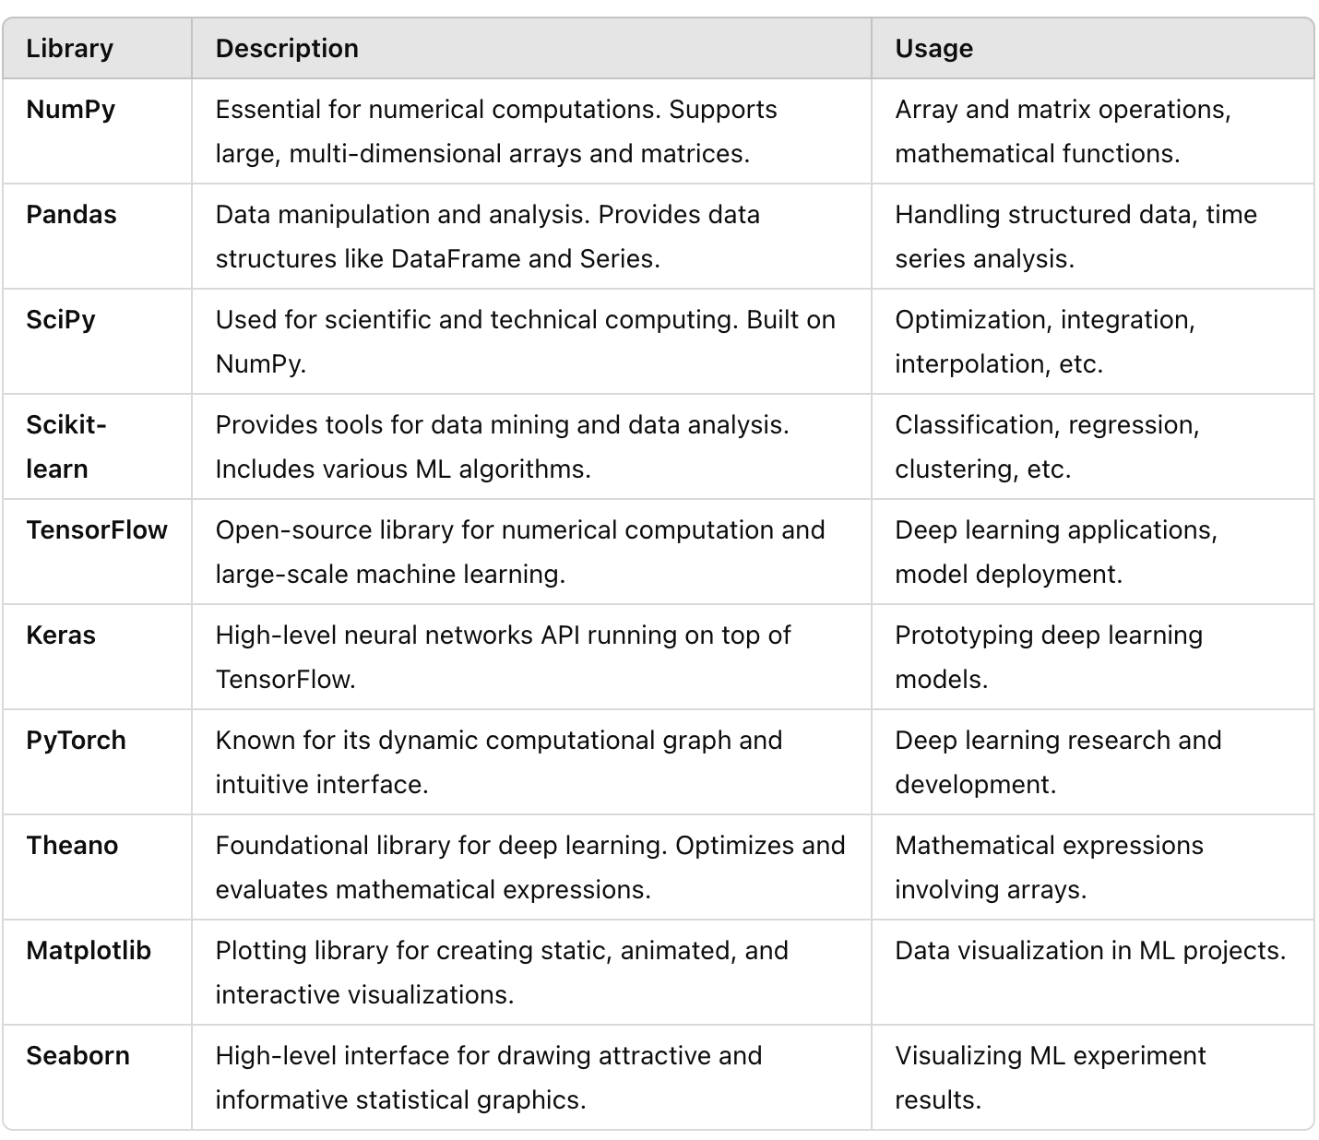
Python Libraries

Slide 72
Demo -sample code links
Variables | link
Operators | link
String | link
List | link
Set | link
Tuple | link
Date | link
Dictionary | link
Control stmts | link
Functions | link
FileIO | link
numpy | link
pandas | link
pytorch | link
PROJECT1(basic) | link
PROJECT1(advanced) | link

Slide 73
Python uniqueness
Tuples
Dict
// operator
Lambda function
Range
** operator
“”” print syntax
F” “
# inline comments
Return a,b
a,b = 2,5
Continue,pass,break
Random library
Dir function
Sys vs argparse
Match is like case
Positional, keyword orgs
Compare seq objects

Slide 74
Next week Homework
Create a Python program to process a CSV file containing student data, including first name, last name, and marks for three subjects: Maths, English, and Science. The program should calculate statistical metrics (mean, median, maximum, and minimum) for each subject and compute the GPA and overall class rank for each student. The GPA should be on a scale of 4, with 4 being the highest, corresponding to perfect scores in all subjects. The output should include the original student data with additional columns for class rank and GPA.

Slide 75
Advanced Python Next week Homework
"I aim to develop a predictive model leveraging historical vehicle data. The model will utilize attributes such as vehicle make, model, manufacturing year, and mileage to forecast the maximum potential lifespan of a vehicle.
Initially, I'll gather historical data for a specific vehicle make, recording various models along with their respective manufacturing years and mileage. This data will serve as the foundation for training the predictive model.
Once the historical data is collected, I'll train a machine learning model using regression techniques, tailoring it to predict the maximum lifespan of vehicles based on their manufacturing year and mileage. The model will learn from the historical data to make accurate predictions.
Upon completion of model training, I'll deploy the model to accept new vehicle data as input. Users will provide details such as vehicle make, model, manufacturing year, and mileage, for which the model will generate a forecast of the vehicle's maximum potential lifespan.
By implementing this predictive model, I aim to assist users in estimating the longevity of their vehicles, enabling informed decision-making regarding maintenance and replacement strategies."
Hint: use SKLEARN and LinerRegression

Slide 76
Neural Network Project Using any ML pkg
Go to any public available data sets of reviews for movies or restaurants and based on review classify the data is Positive/Negative or Neutral
Positive Review
"This film is a masterpiece of storytelling, featuring exceptional performances by the cast. The cinematography is stunning, and the direction is impeccable. It's a deeply emotional experience that will leave you thinking long after the credits roll. Highly recommend to anyone looking for a powerful and moving cinematic journey."
Negative Review
"This movie was a huge disappointment. The plot was incoherent, and the characters were poorly developed. The special effects looked cheap, and the dialogue was cringeworthy. It felt like a waste of time and money. I wouldn't recommend this to anyone."
Neutral Review
"The movie had its moments of brilliance, with some well-executed scenes and decent acting. However, it struggled with pacing issues, and some parts felt dragged out. It's an average film that might appeal to fans of the genre but doesn't stand out as particularly memorable or groundbreaking."

Slide 77
Neural Networks

Slide 78
What is Neural Networks
A neural network is a method in artificial intelligence that teaches computers to process data in a way that is inspired by the human brain. It is a type of machine learning process, called deep learning, that uses interconnected nodes or neurons in a layered structure that resembles the human brain. It creates an adaptive system that computers use to learn from their mistakes and improve continuously. Thus, artificial neural networks attempt to solve complicated problems, like summarizing documents or recognizing faces, with greater accuracy.

Slide 79
Types
Perceptron
Multi Layer
Feedforward
Recurrent
Modular
Radial state machine
Liquid state machine
Residual
Convolutional NN
Notes:
https://www.cloudflare.com/learning/ai/what-is-neural-network/

Slide 80
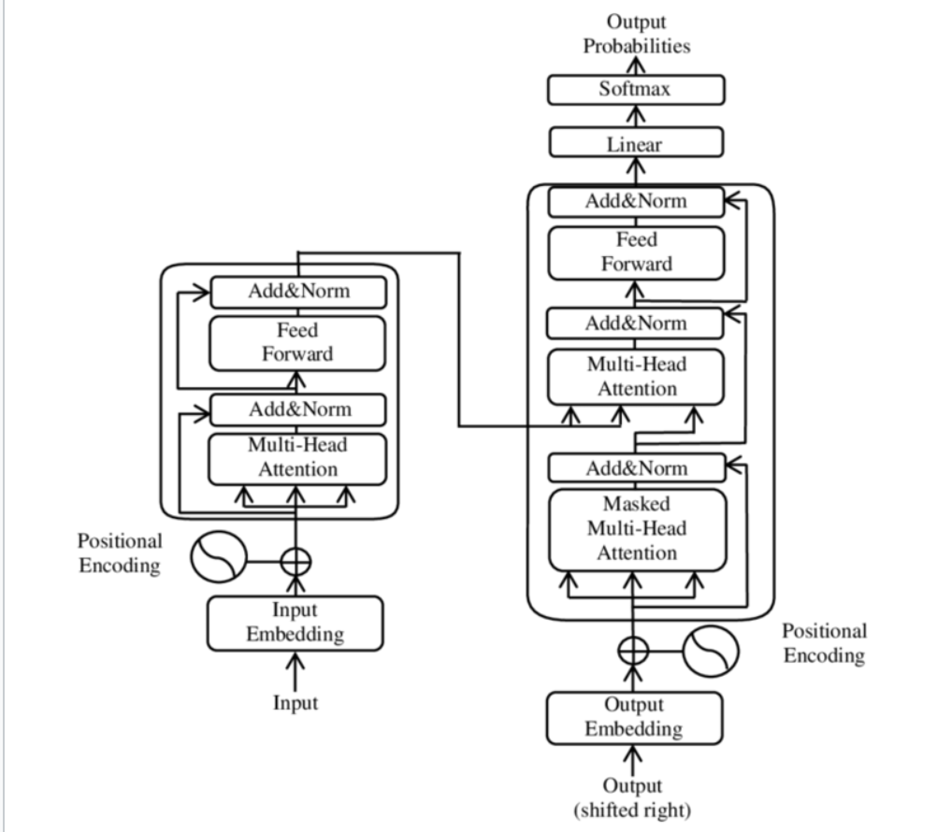
Transformer Architecture

Slide 81
Transformer Neural Networks
Transformer neural networks are worth highlighting because they have assumed a place of outsized importance in the AI models in widespread use today.
First proposed in 2017, transformer models are neural networks that use a technique called "self-attention" to take into account the context of elements in a sequence, not just the elements themselves. Via self-attention, they can detect even subtle ways that parts of a data set relate to each other.
This ability makes them ideal for analyzing (for example) sentences and paragraphs of text, as opposed to just individual words and phrases. Before transformer models were developed, AI models that processed text would often "forget" the beginning of a sentence by the time they got to the end of it, with the result that they would combine phrases and ideas in ways that did not make sense to human readers. Transformer models, however, can process and generate human language in a much more natural way.
Transformer models are an integral component of generative AI, in particular LLMs that can produce text in response to arbitrary human prompts.

Slide 82
ML Algorithms

Slide 83
ML Algorithms
Simple Analogies
Supervised Learning: A student learning math problems with the help of a teacher who provides the correct answers.
Unsupervised Learning: A child sorting a mixed box of Lego pieces by shape and color without any instructions.
Self-Supervised Learning: Reading a book where some words are blanked out and using the surrounding text to guess the missing words.
Semi-Supervised Learning: Learning to cook with a few recipes (labeled data) and experimenting with new ingredients on your own (unlabeled data).
Reinforcement Learning: A video game player trying different strategies to win a game, learning from both wins (rewards) and losses (penalties).

Slide 84
ML Algorithms
1. Supervised Learning
Title: Learning with a Teacher
Description: In supervised learning, the algorithm learns from labeled data. It's like having a teacher who provides both questions and answers. For example, if you're learning to recognize animals, you get a bunch of pictures of animals (the input) with labels like "cat" or "dog" (the output). The algorithm uses these examples to learn how to classify new images.
2. Unsupervised Learning
Title: Learning without a Teacher
Description: Unsupervised learning deals with unlabeled data. There are no answers provided, so the algorithm tries to find patterns and structure on its own. It's like exploring a new place without a map and figuring out the layout by yourself. An example is clustering, where the algorithm groups similar items together, like organizing a pile of mixed candies by color or type.

Slide 85
ML Algorithms
3. Self-Supervised Learning
Title: Learning from Itself
Description: In self-supervised learning, the algorithm generates its own labels from the data. It's like solving a puzzle where some pieces are missing, and you have to figure out the missing parts from the surrounding pieces. An example is a language model predicting the next word in a sentence, where the sentence itself provides context.
4. Semi-Supervised Learning
Title: A Mix of Learning with and without a Teacher
Description: Semi-supervised learning uses a combination of labeled and unlabeled data. It's like having a few questions with answers and a lot of questions without answers. The algorithm learns from the labeled data and uses this knowledge to make sense of the unlabeled data. This approach is useful when labeling data is expensive or time-consuming.
5. Reinforcement Learning
Title: Learning by Trial and Error
Description: Reinforcement learning involves learning by taking actions and receiving rewards or penalties. It's like training a dog where good behavior is rewarded with treats and bad behavior is discouraged. The algorithm learns the best actions to take in different situations to maximize rewards over time. This is often used in game playing and robotics.

Slide 86
ML Algorithms
1. Linear Regression
2. Logistic Regression
3. Decision Trees
4. Random Forest
5. K-Nearest Neighbors (KNN)
6. Support Vector Machines (SVM)
7. Naive Bayes
8. K-Means Clustering
9. Principal Component Analysis (PCA)
10. Neural Networks
11. Reinforcement Learning

Slide 87
ML Algorithms
1. Linear Regression
Title: Predicting a Continuous Value
Description: Linear Regression is like drawing a straight line through a set of points on a graph to find a trend. For example, if you have data on house sizes and their prices, you can use linear regression to predict the price of a house based on its size.
2. Logistic Regression
Title: Predicting Categories
Description: Logistic Regression helps to categorize things into groups. It's like sorting emails into "spam" or "not spam" by looking at the content. Even though it's called regression, it's used for classification.
3. Decision Trees
Title: Making Decisions with If-Else
Description: Decision Trees work like a flowchart of decisions. Each decision is a branch, and the final outcomes are leaves. For instance, you might decide whether to play outside based on weather: if it's sunny, go play; if it's rainy, stay inside.
.

Slide 88
ML Algorithms
4. Random Forest
Title: A Forest of Decision Trees
Description: Random Forests are a bunch of decision trees working together. Each tree gives a vote, and the majority vote decides the final outcome. It's like asking multiple experts for their opinion and choosing the most common answer.
5. K-Nearest Neighbors (KNN)
Title: Finding Similar Things
Description: KNN looks at the closest examples to make a decision. If you want to know if a fruit is an apple or an orange, you look at the nearest fruits. If most nearby fruits are apples, it's likely an apple.
6. Support Vector Machines (SVM)
Title: Drawing the Best Boundary
Description: SVM finds the best line or boundary that separates different groups. Imagine drawing a line on the ground to separate cats from dogs. The SVM ensures this line is as far away from both groups as possible.

Slide 89
ML Algorithms
7. Naive Bayes
Title: Probabilistic Classifier
Description: Naive Bayes is based on probability. It calculates the likelihood that something belongs to a category based on past data. For example, it might predict if a message is spam based on the frequency of certain words.
8. K-Means Clustering
Title: Grouping Similar Items
Description: K-Means groups similar items into clusters. It's like organizing a pile of mixed candies into groups based on color. The algorithm keeps refining the groups until the items in each group are very similar.
9. Principal Component Analysis (PCA)
Title: Reducing Dimensionality
Description: PCA simplifies data by reducing the number of dimensions (features) while preserving important information. Think of it as summarizing a long book into a shorter version without losing the main points.

Slide 90
ML Algorithms
10. Neural Networks
Title: Mimicking the Brain
Description: Neural Networks are like a simplified version of the human brain. They consist of interconnected nodes (neurons) that process information and learn patterns. They're used in applications like image recognition and language processing.
11. Reinforcement Learning
Title: Learning by Rewards
Description: Reinforcement Learning is like training a pet. The algorithm learns by trying actions and receiving rewards or penalties. Over time, it learns the best actions to maximize rewards, like a dog learning tricks for treats.

Slide 91
ML algorithms Code Sample Gitlab links
1. Linear Regression | 7. Naive Bayes
2. Logistic Regression | 8. K-Means Clustering
3. Decision Trees | 9. Principal Component Analysis (PCA)
4. Random Forest | 10. Neural Networks
5. K-Nearest Neighbors (KNN) | 11. Reinforcement Learning
6. Support Vector Machines (SVM)

Slide 92
Transformers

Slide 93
What it is ? - READ
Transformers are a type of neural network architecture in artificial intelligence (AI) that can change an input sequence into an output sequence. They do this by learning the context and relationships between the components of the sequence. Transformer models are a key part of generative AI and are used in many applications, including: Natural language processing (NLP), Translating text and speech, Understanding DNA and proteins, Drug discovery, and Medical research.

Slide 94
The Sky is ?
How a transformer model processes an input sentence, generates a context-aware response, and learns to improve its predictions through training. Understanding each key term and its role helps demystify how advanced AI models like transformers operate to generate accurate and relevant responses

Slide 95
The Sky is ?
How a transformer model processes an input sentence, generates a context-aware response, and learns to improve its predictions through training. Understanding each key term and its role helps demystify how advanced AI models like transformers operate to generate accurate and relevant responses

Slide 96
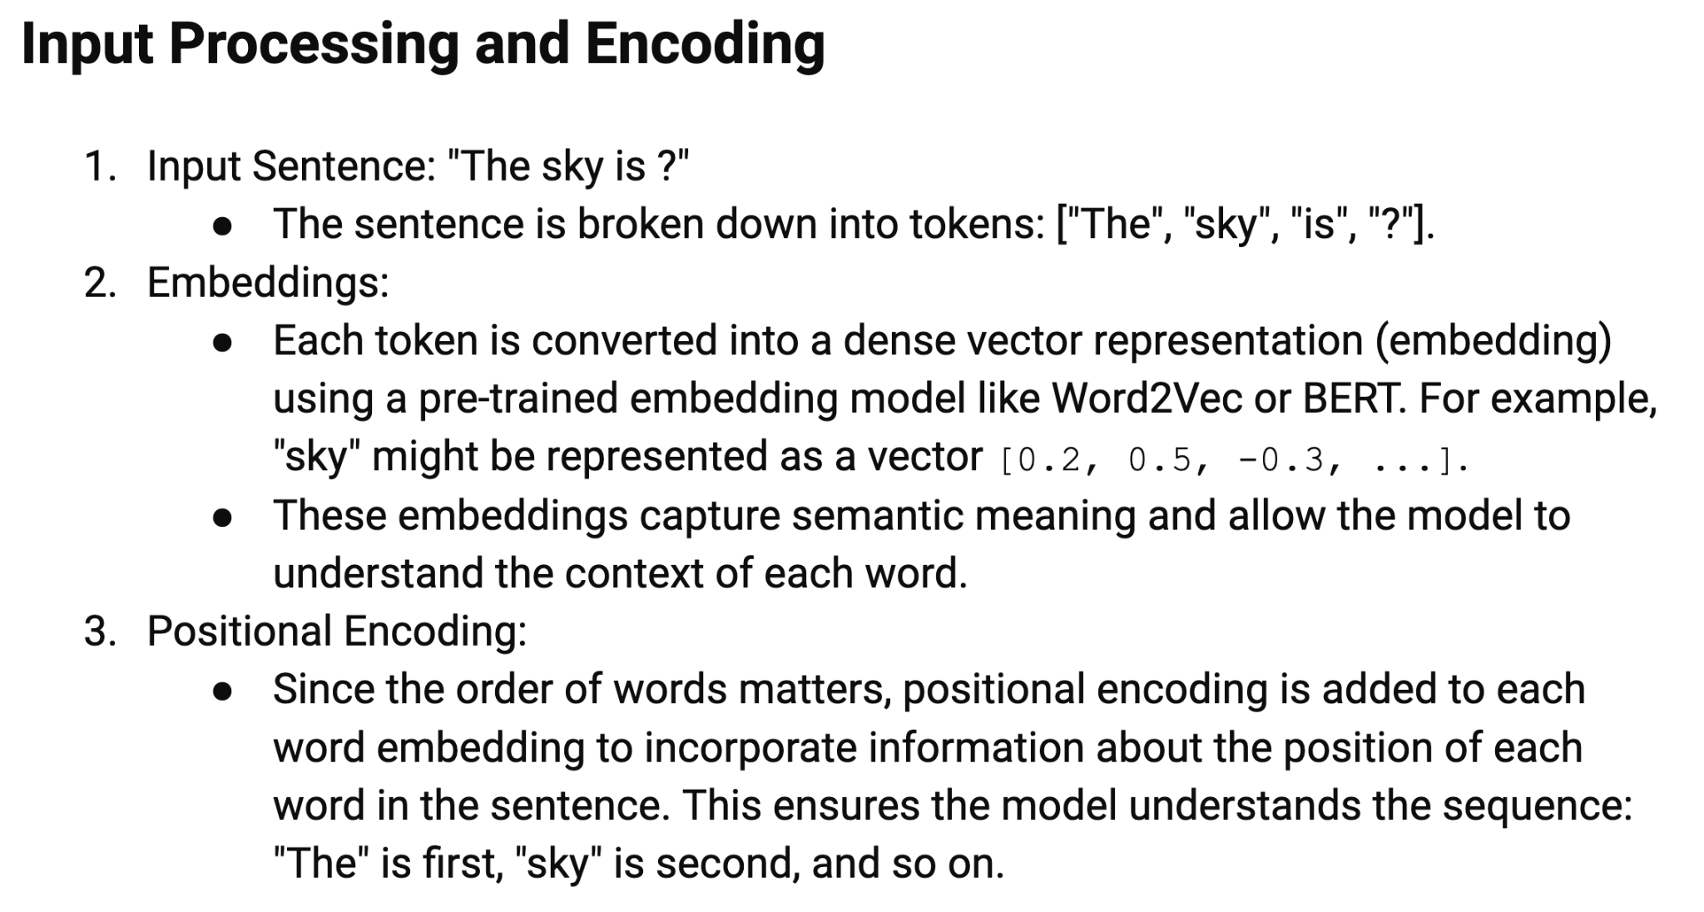

Slide 97
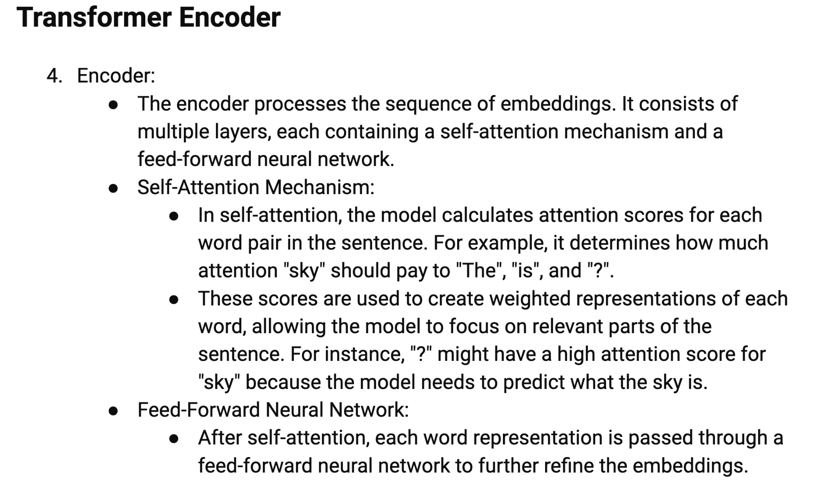

Slide 98
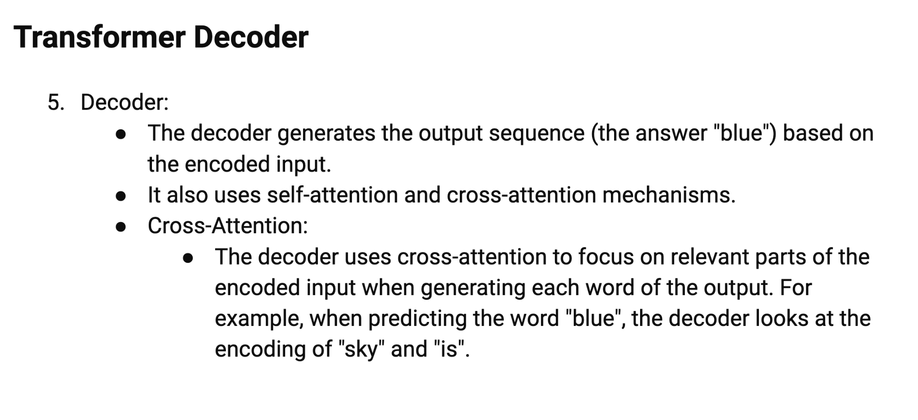

Slide 99
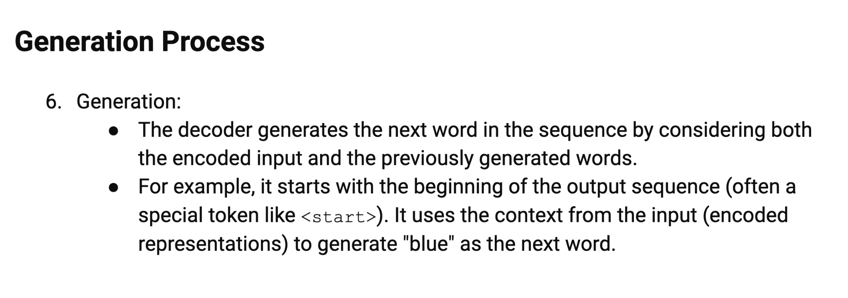

Slide 100
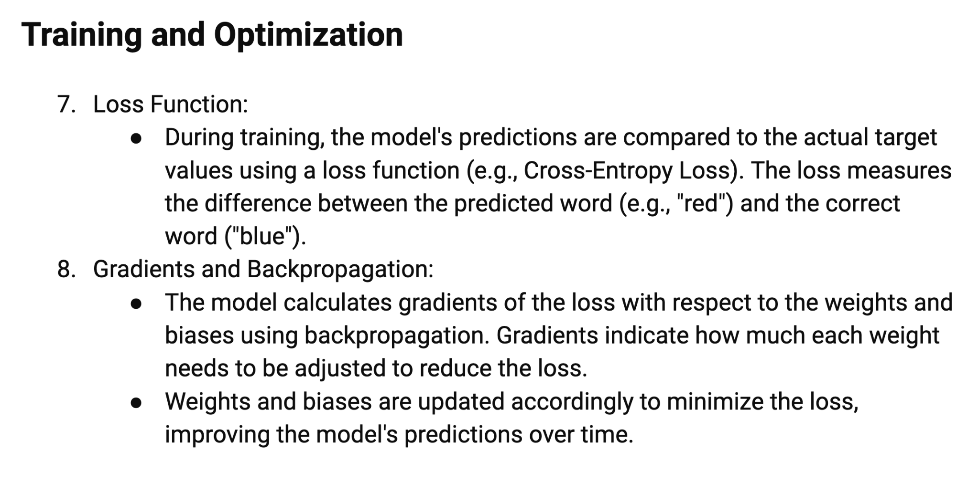

Slide 101
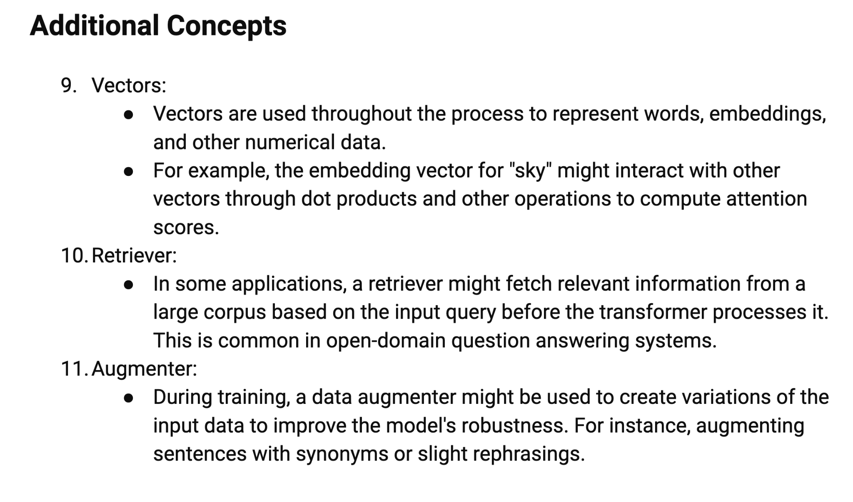

Slide 102
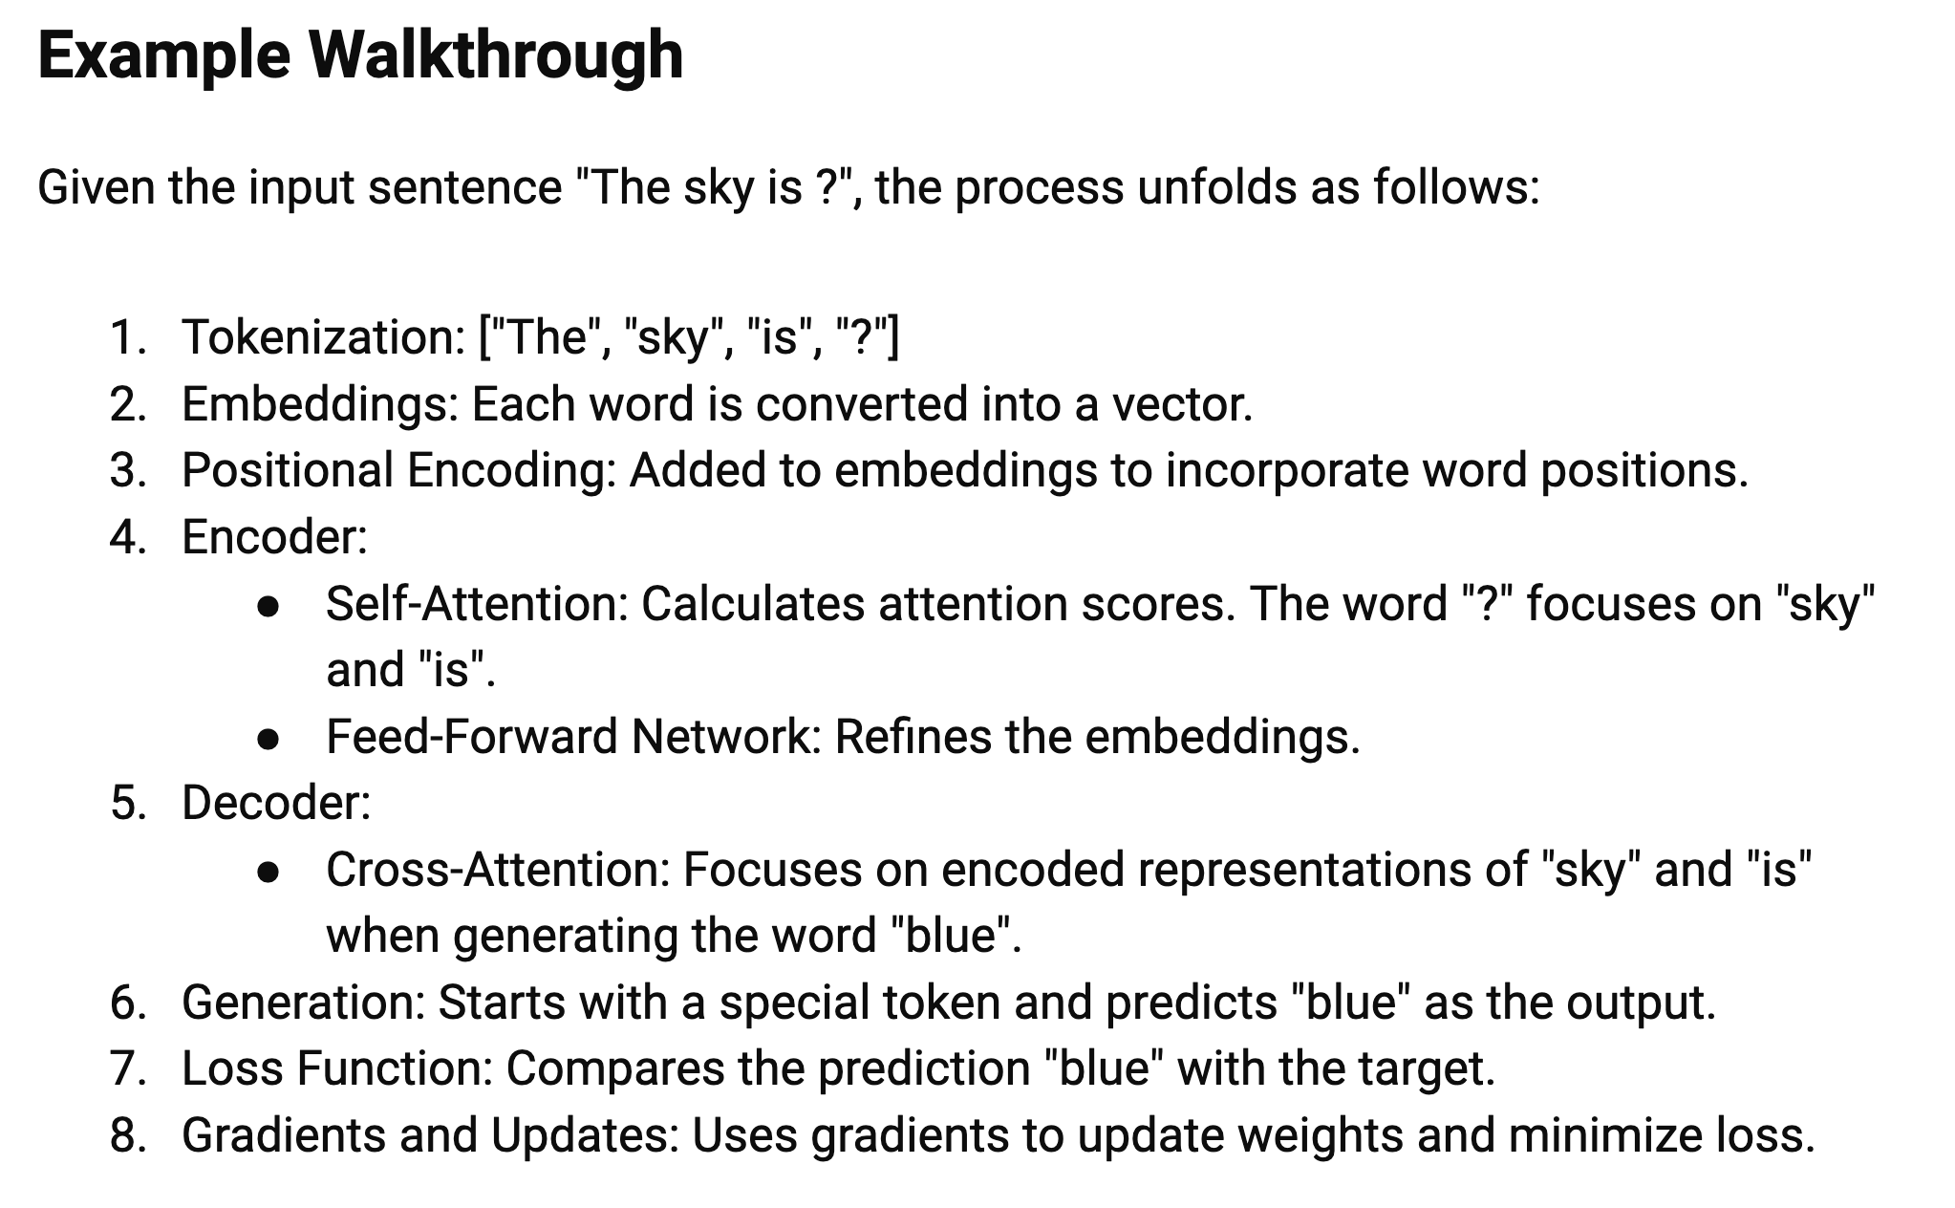

Slide 103
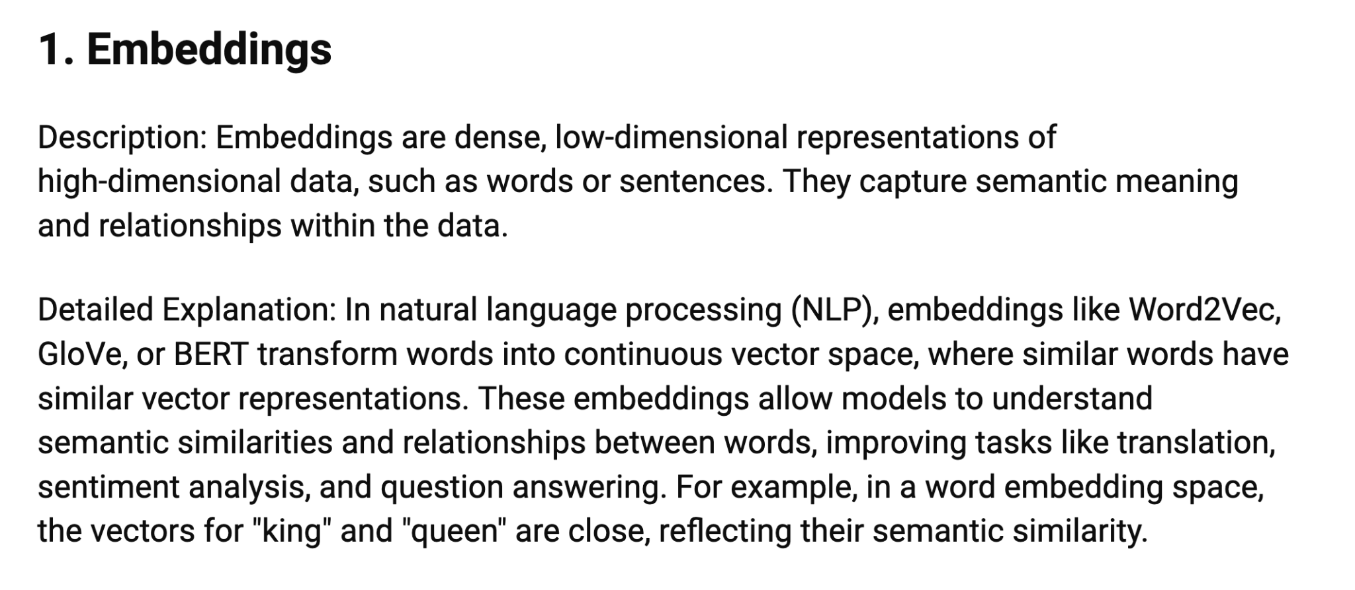

Slide 104
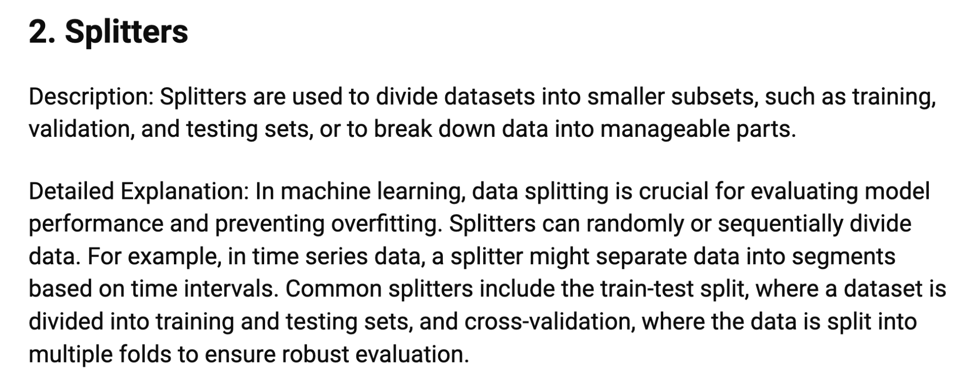

Slide 105
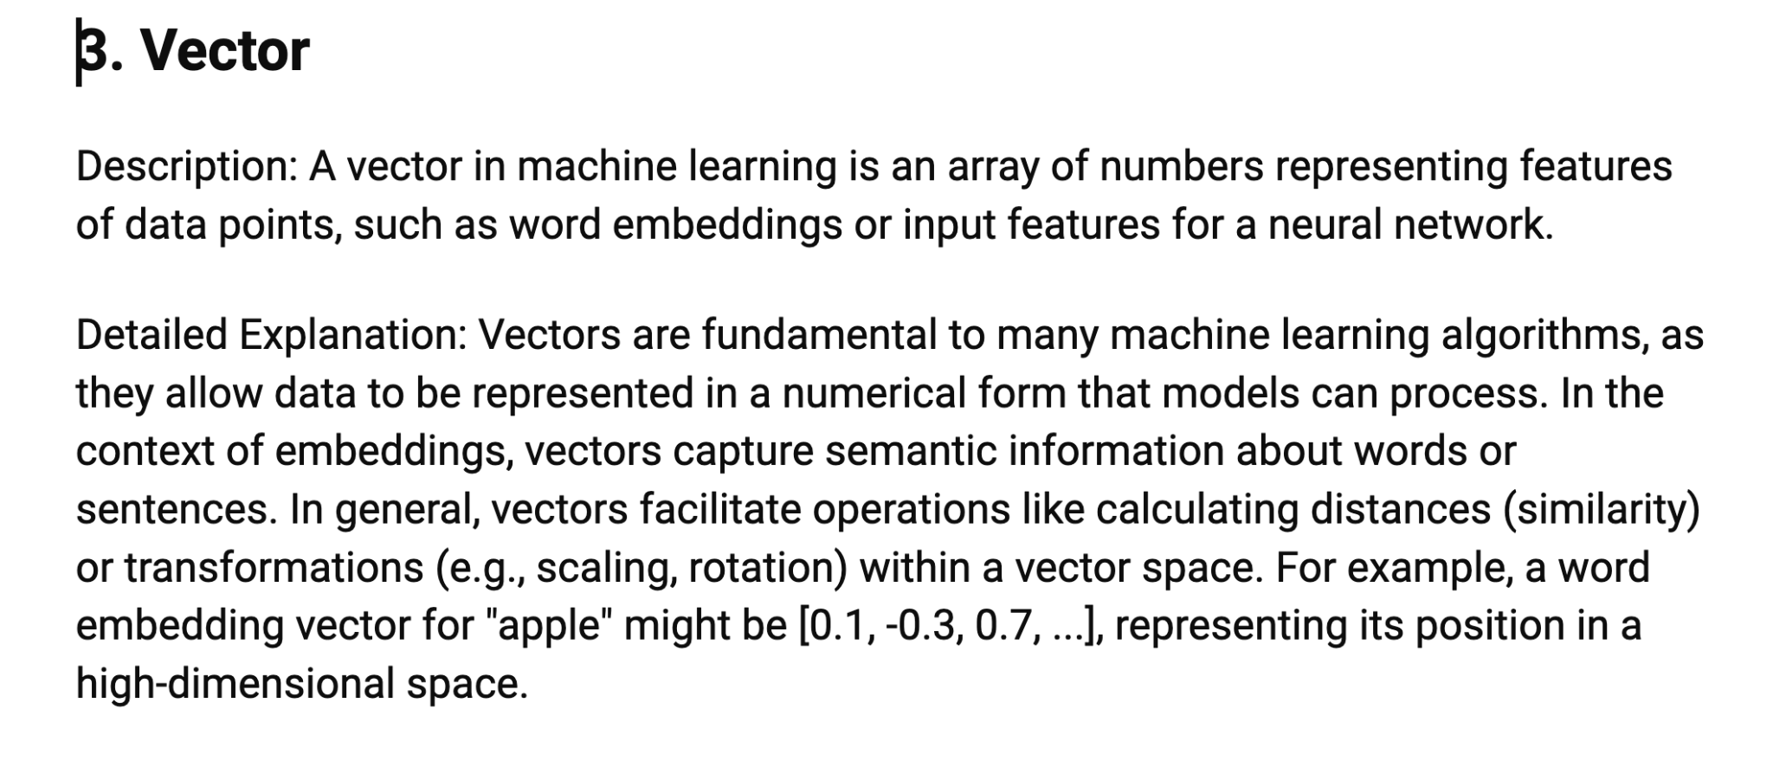

Slide 106
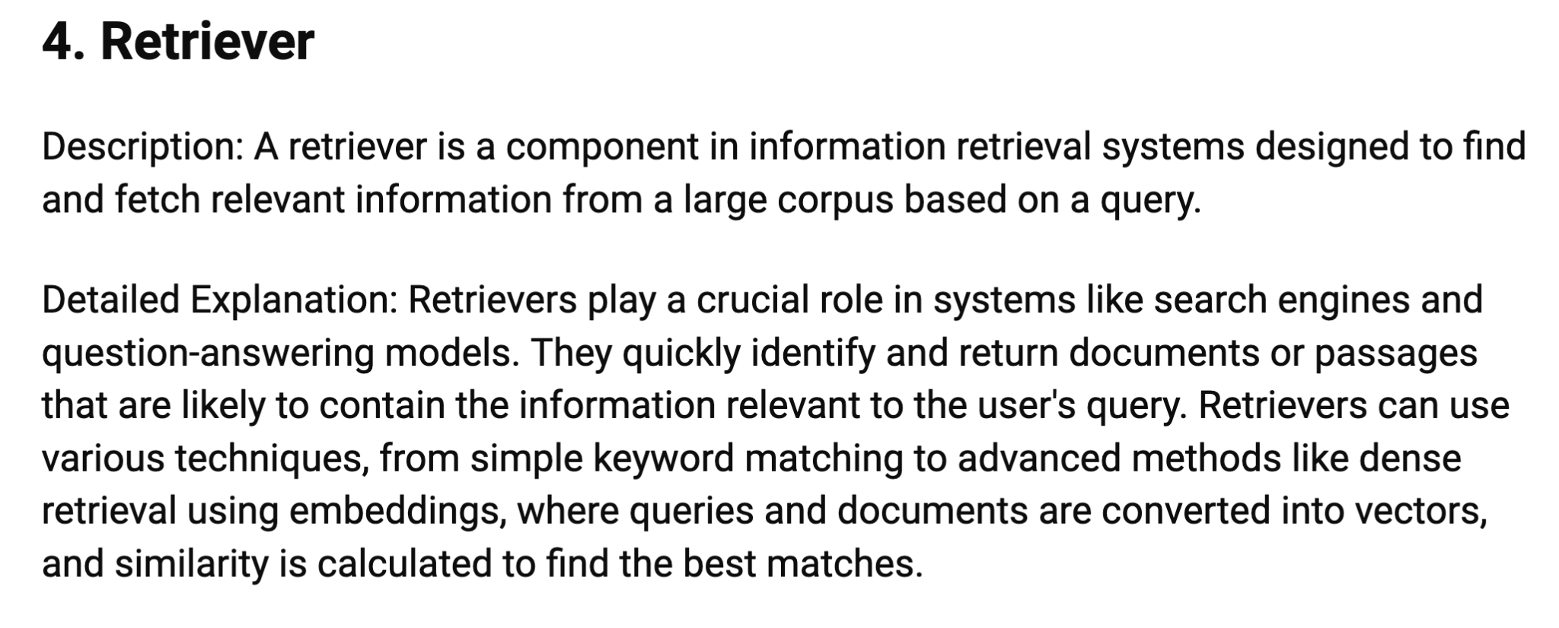

Slide 107
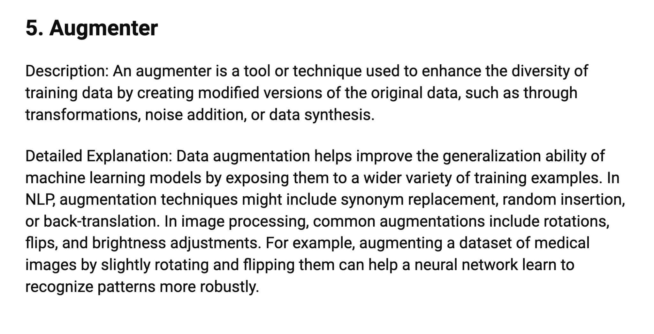

Slide 108
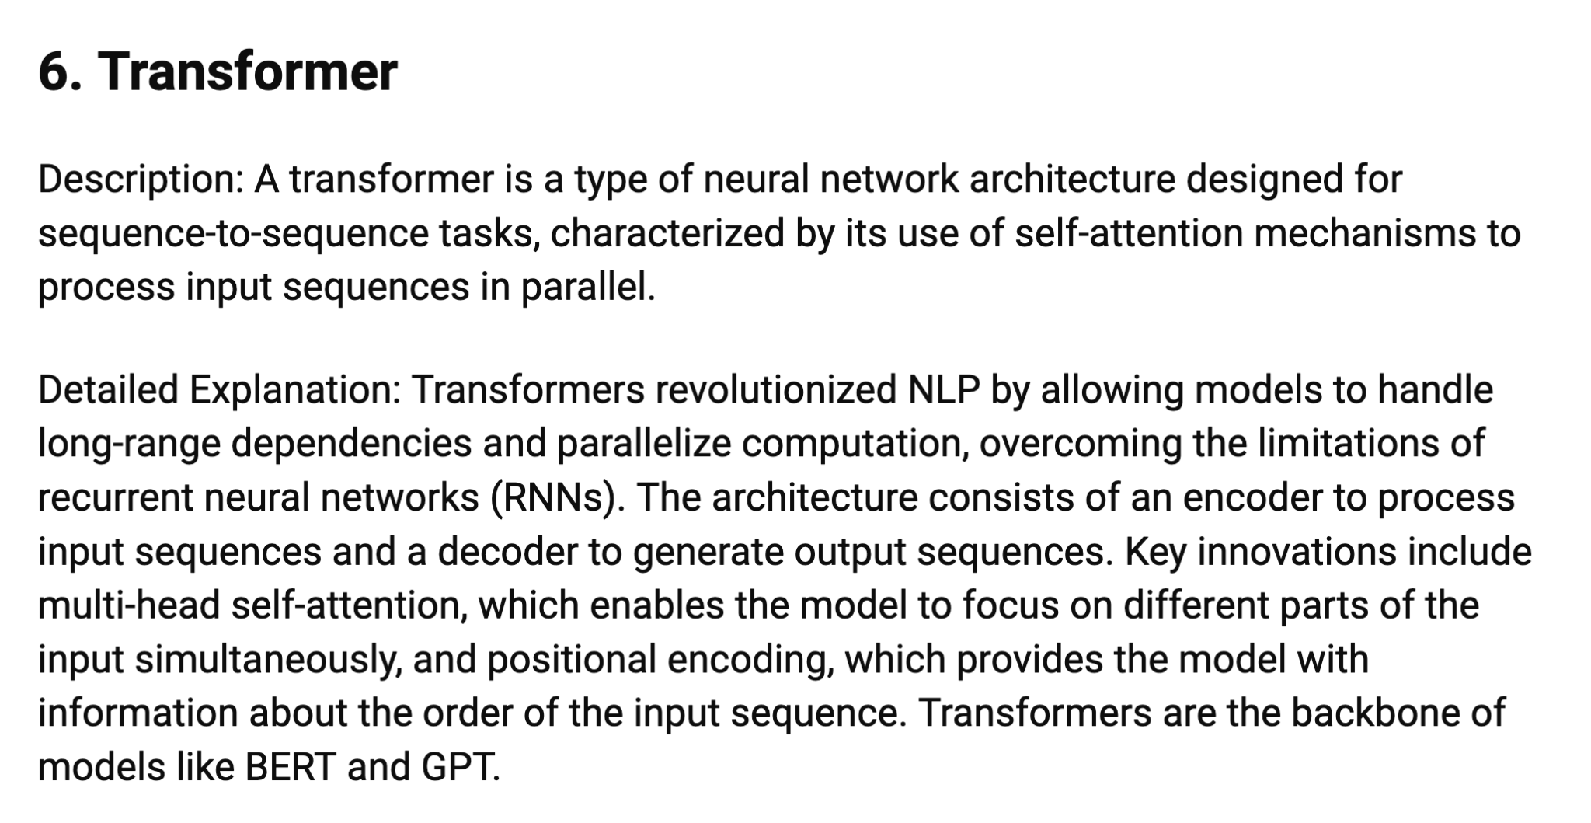

Slide 109
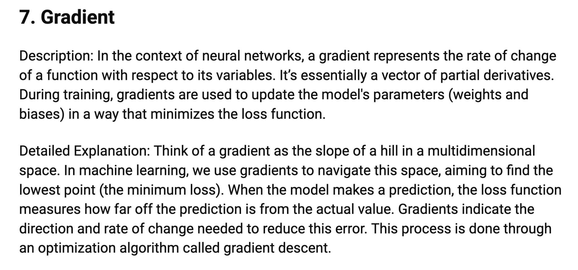

Slide 110
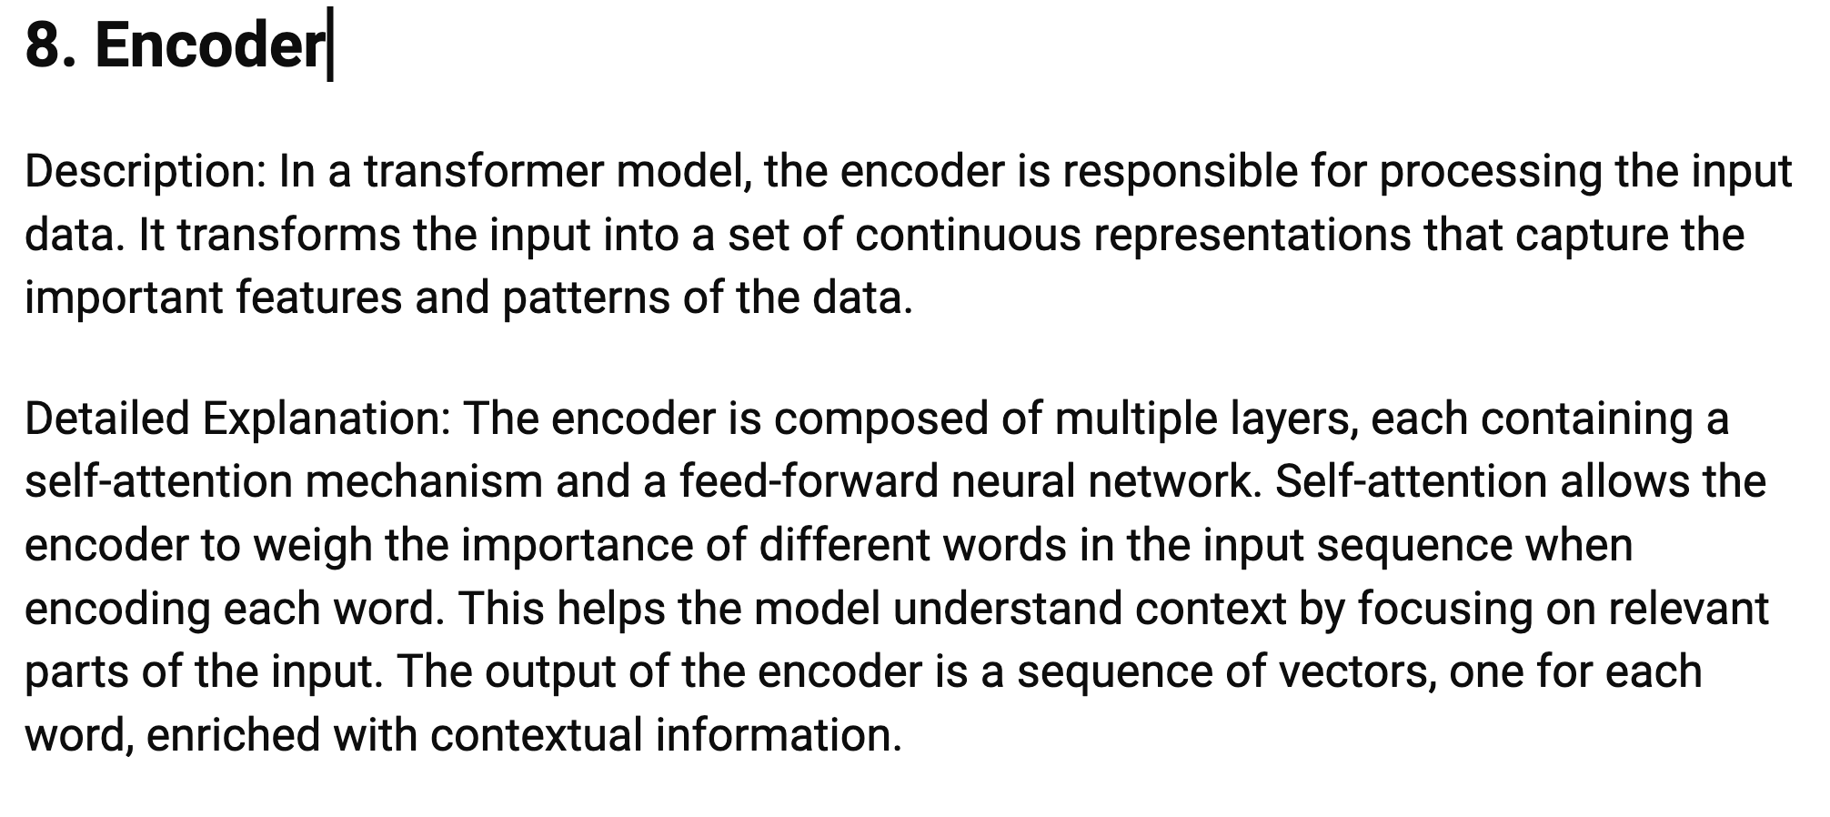

Slide 111
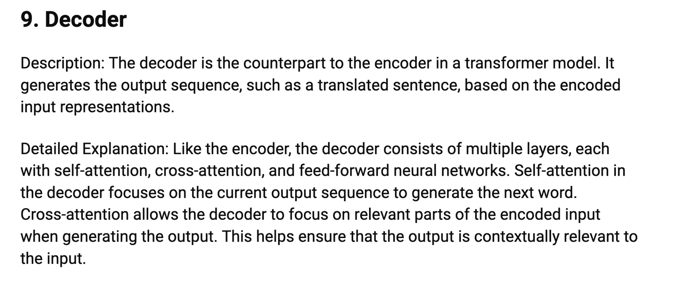

Slide 112
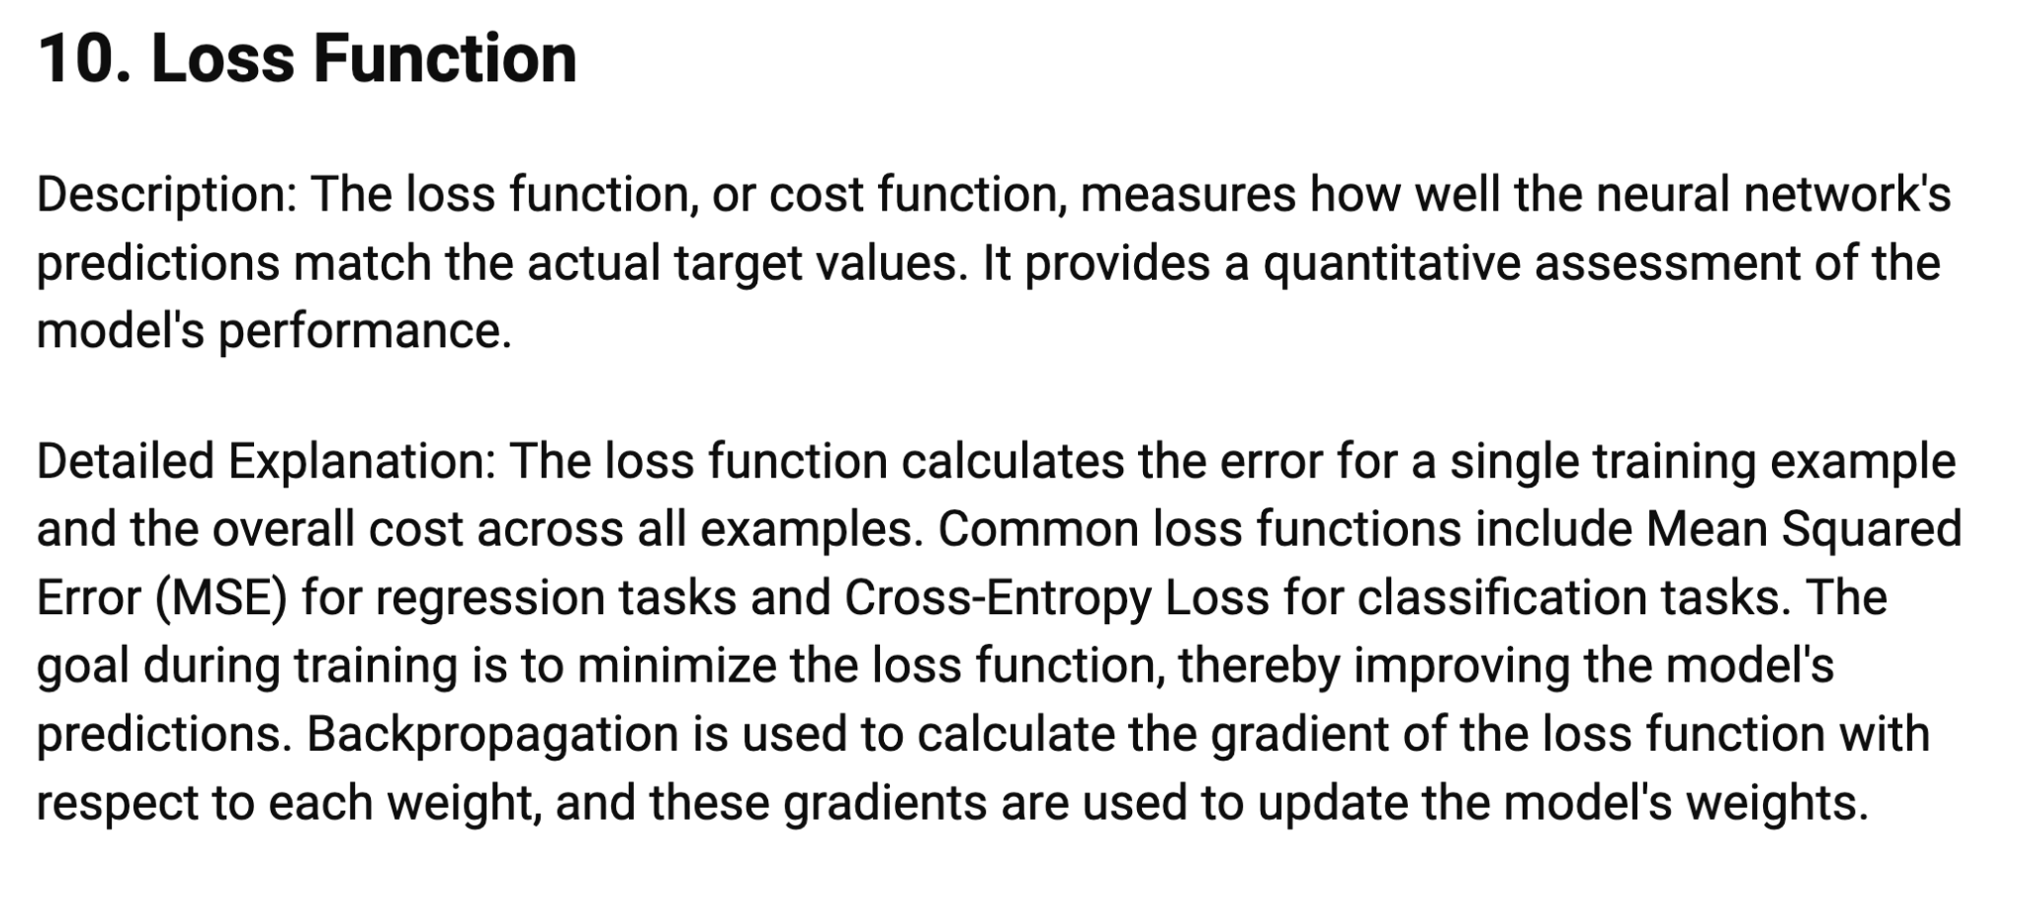

Slide 113
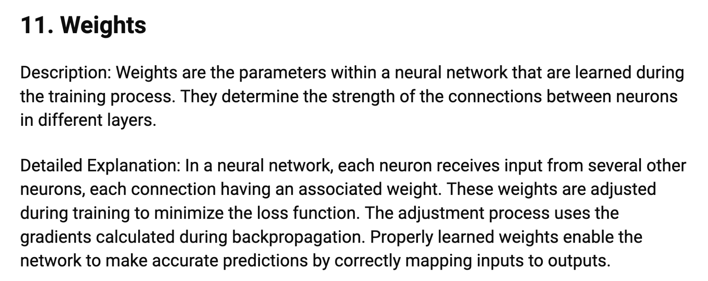

Slide 114
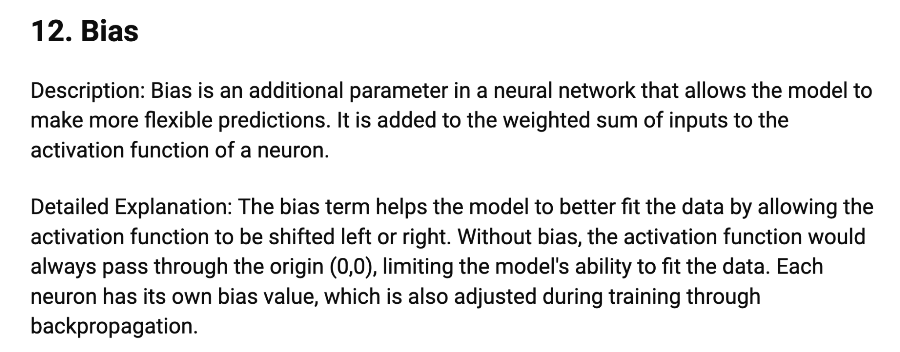

Slide 115
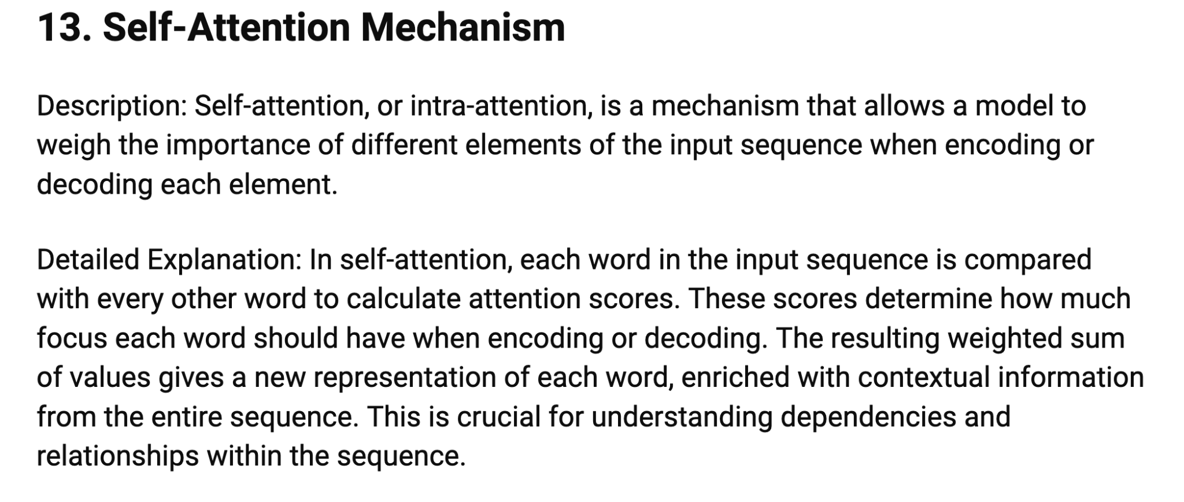

Slide 116
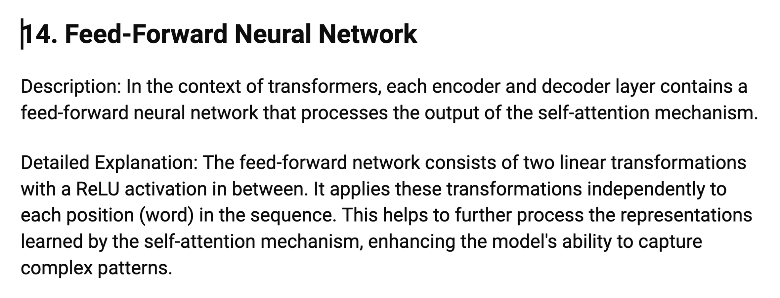

Slide 117
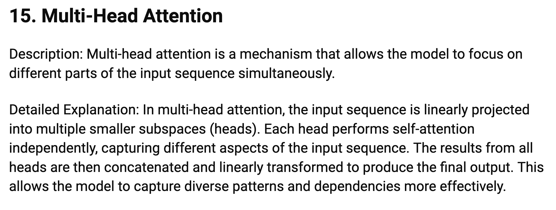

Slide 118
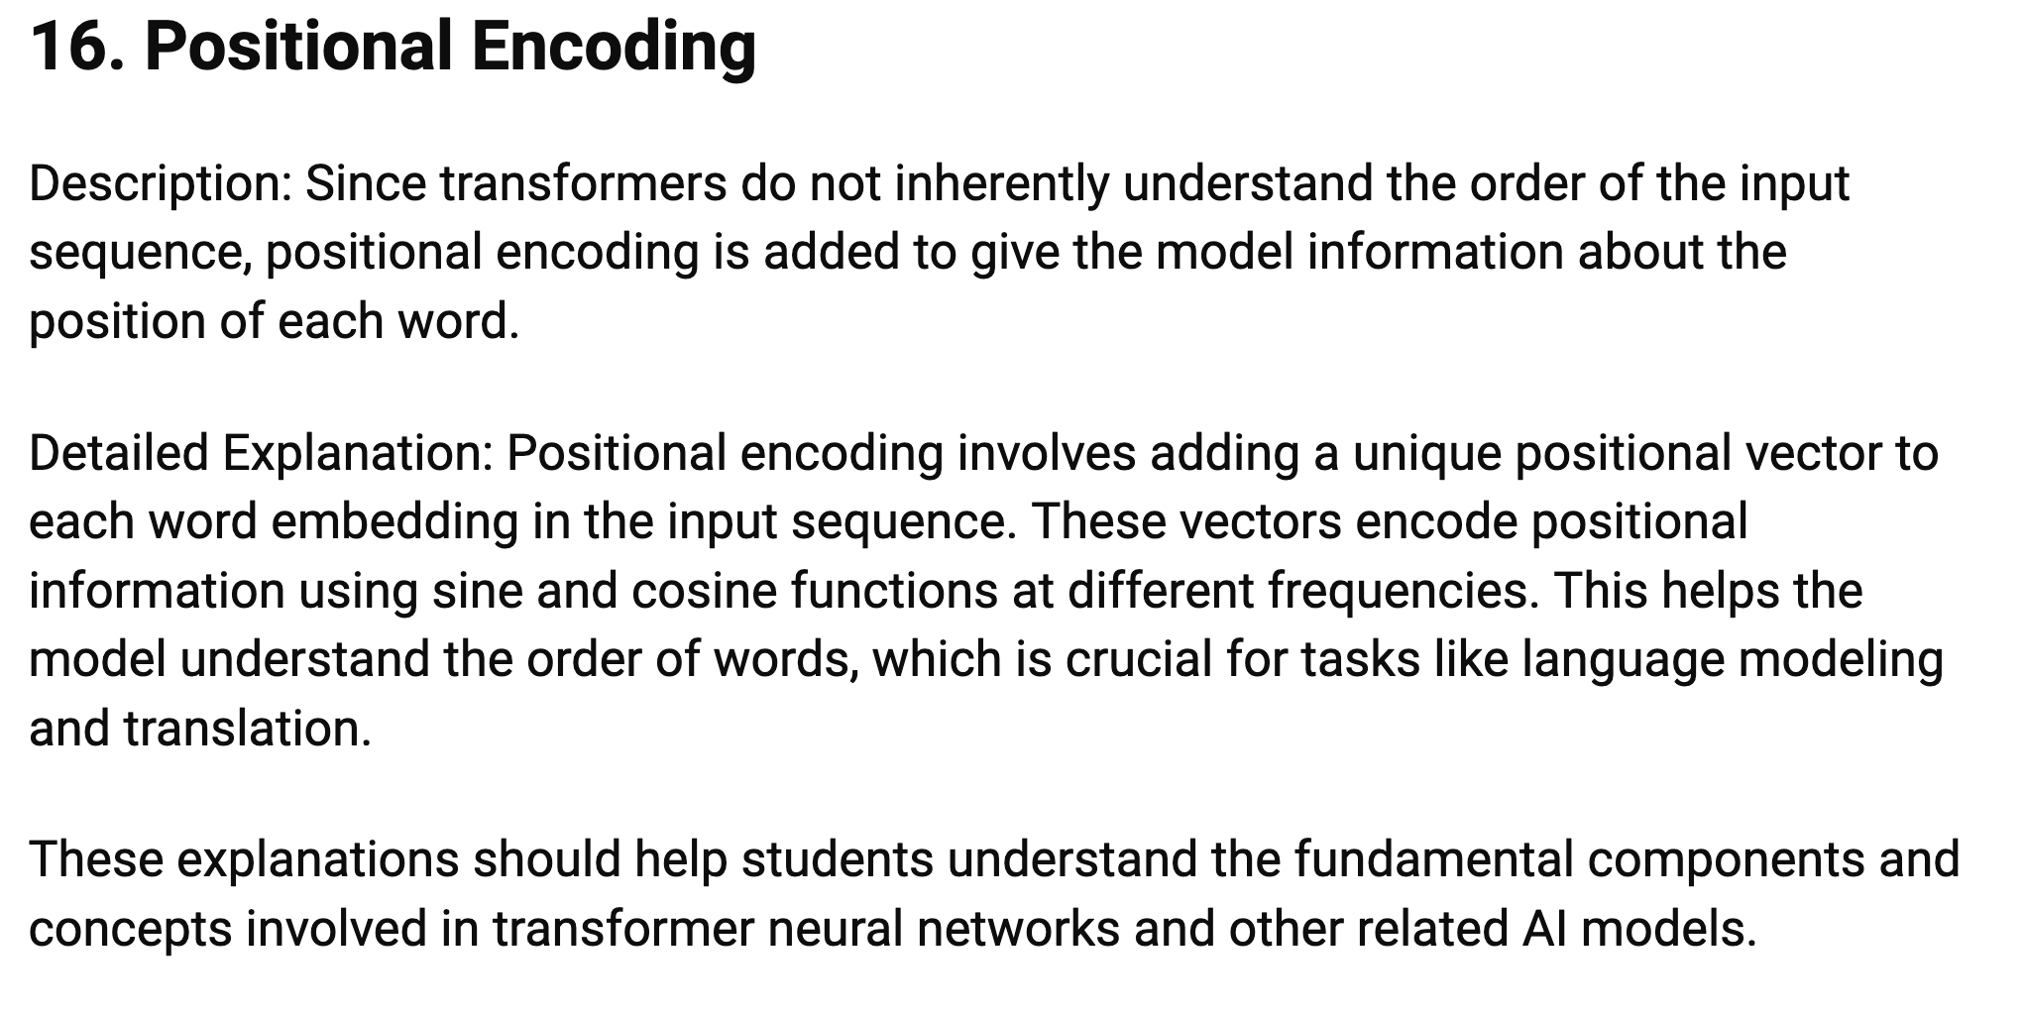

Slide 122
Prompt Engineering

Slide 123
What is Prompt Engineering?
Prompt engineering is the process of structuring an instruction that can be interpreted and understood by a generative AI model.^{[1][2]} A prompt is natural language text describing the task that an AI should perform

Slide 124
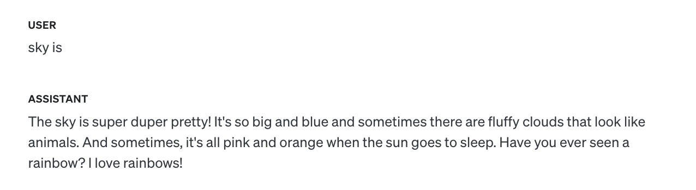
LLM System context (Act like a 5 year old boy)
The sky is …

Slide 125
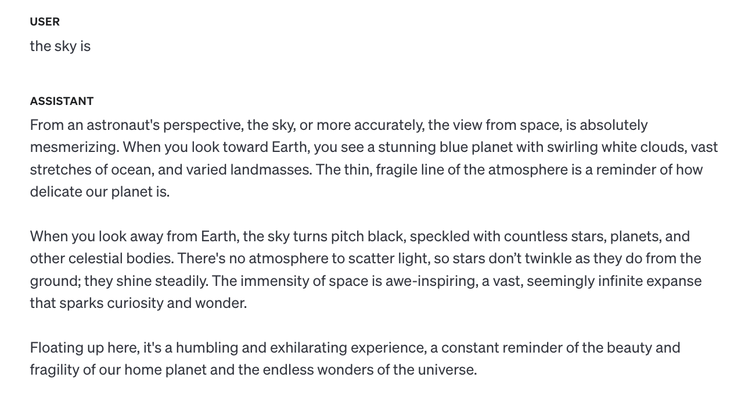
LLM System context (Act like an astronaut)
The sky is …

Slide 126
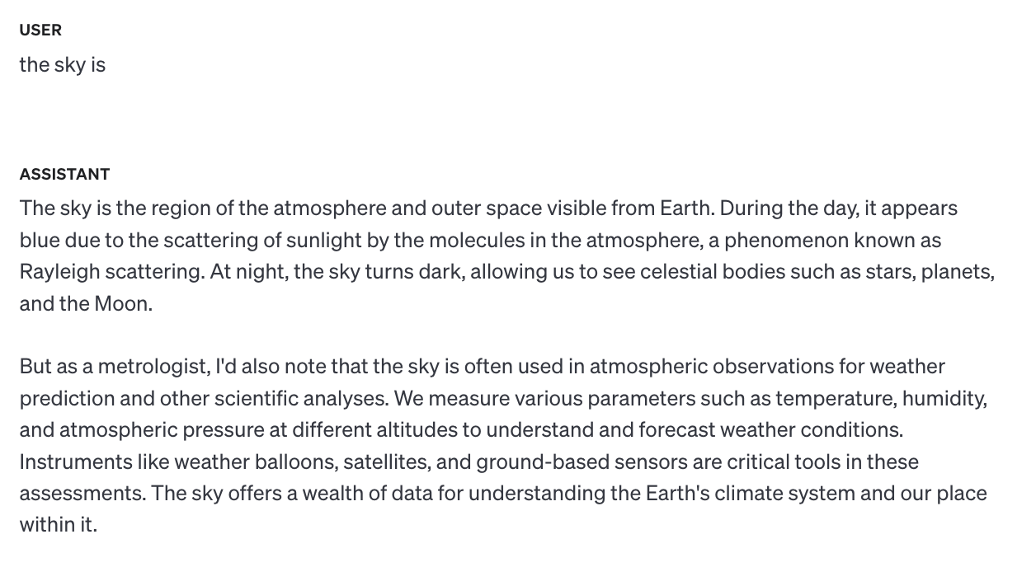
LLM System context (Act like a metrologist)
The sky is …

Slide 127
Prompt Engineering Types Google Link
Zero Shot
One Shot
Few Shot
Chain of Thought
Tree of Thoughts
Notes:
https://medium.com/@amiraryani/8-types-of-prompt-engineering-5322fff77bdf

Slide 128
Definitions of Types of Prompting styles
Zero Shot: Making predictions without prior task-specific training. Useful in sentiment analysis and classification tasks.
One Shot: Learning from a single example to generalize. Useful in tasks like text classification.
Few Shot: Learning from a few examples to understand and perform tasks. Useful in text completion and generation.
Chain of Thought: Step-by-step reasoning to solve complex tasks. Useful in arithmetic and logical problem solving.
Tree of Thought: Exploring multiple branches of reasoning for decision-making. Useful in strategic planning and game theory.

Slide 129
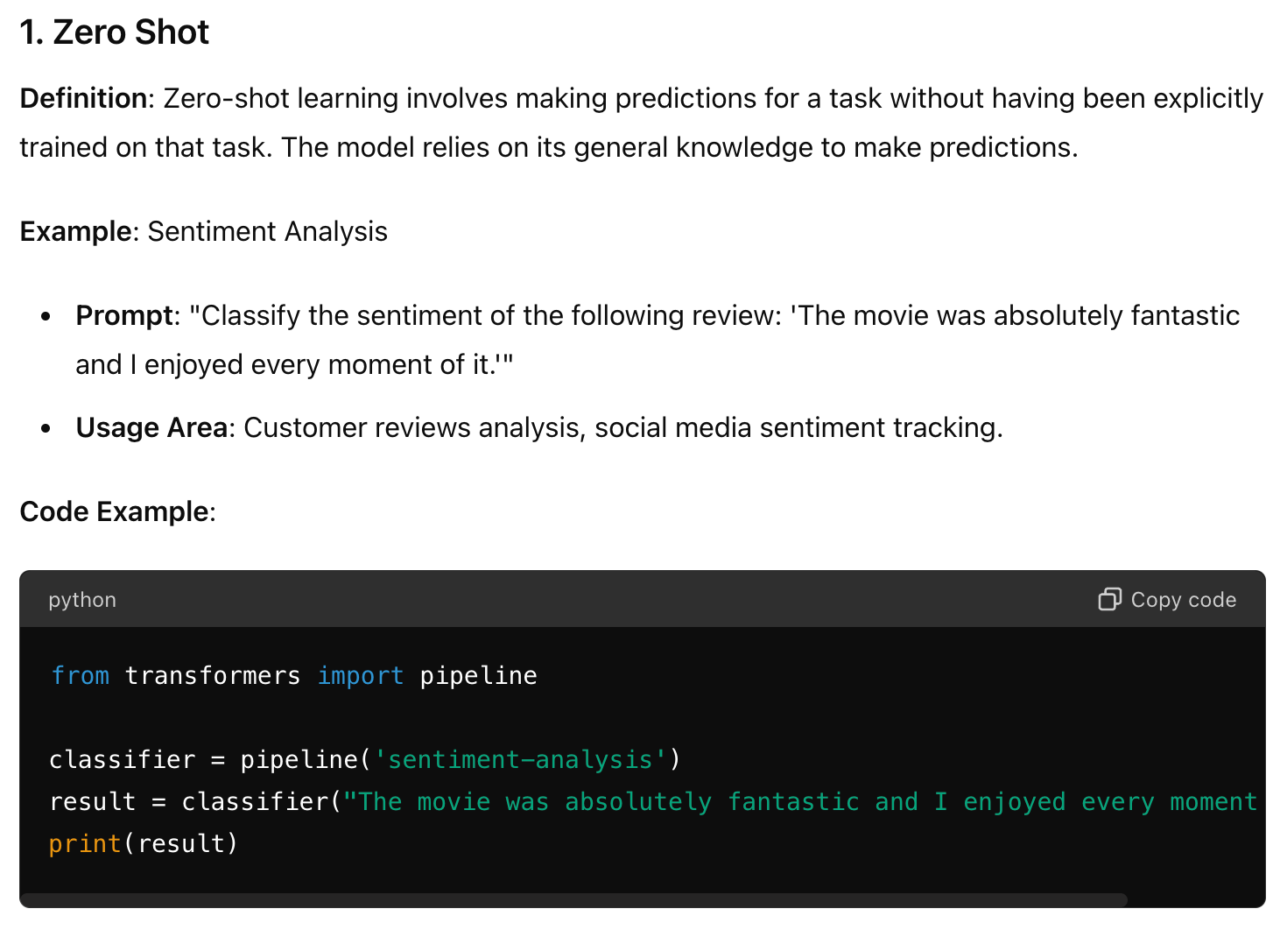

Slide 130
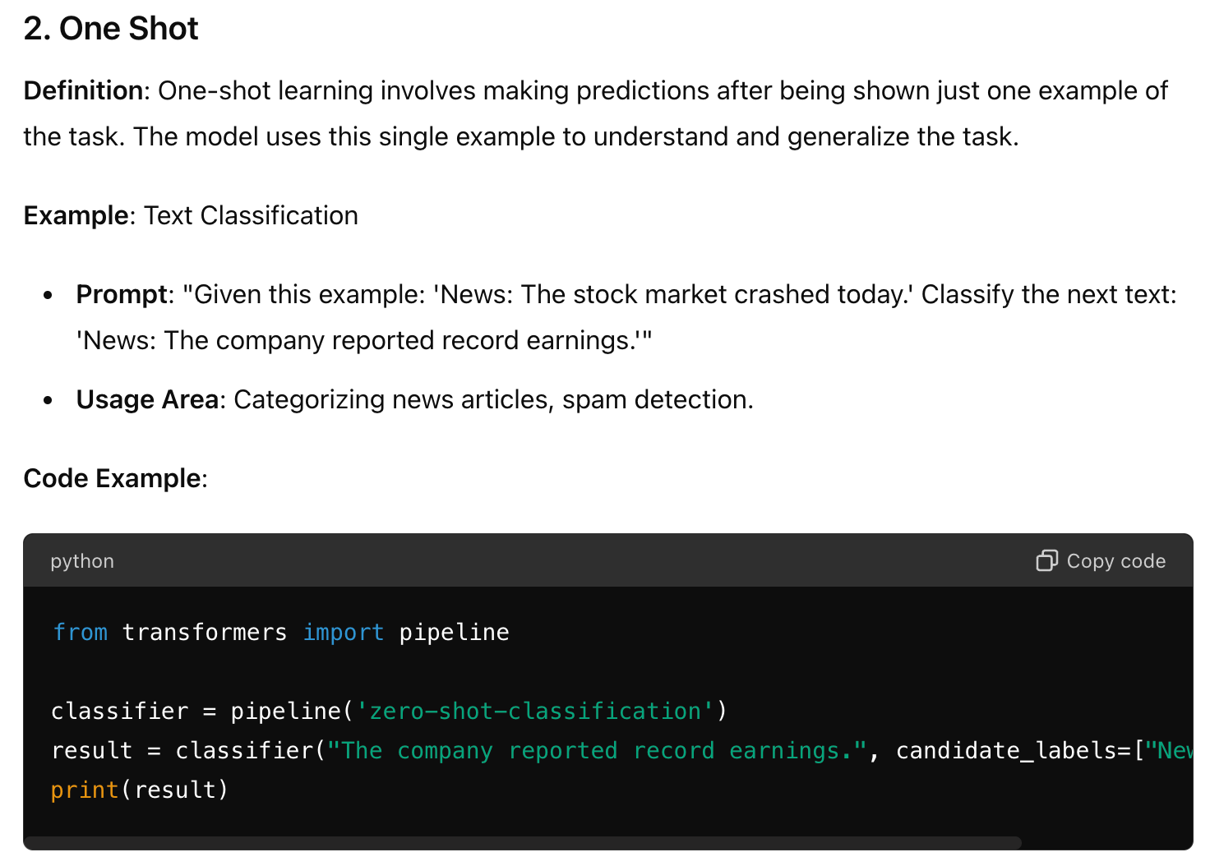

Slide 131
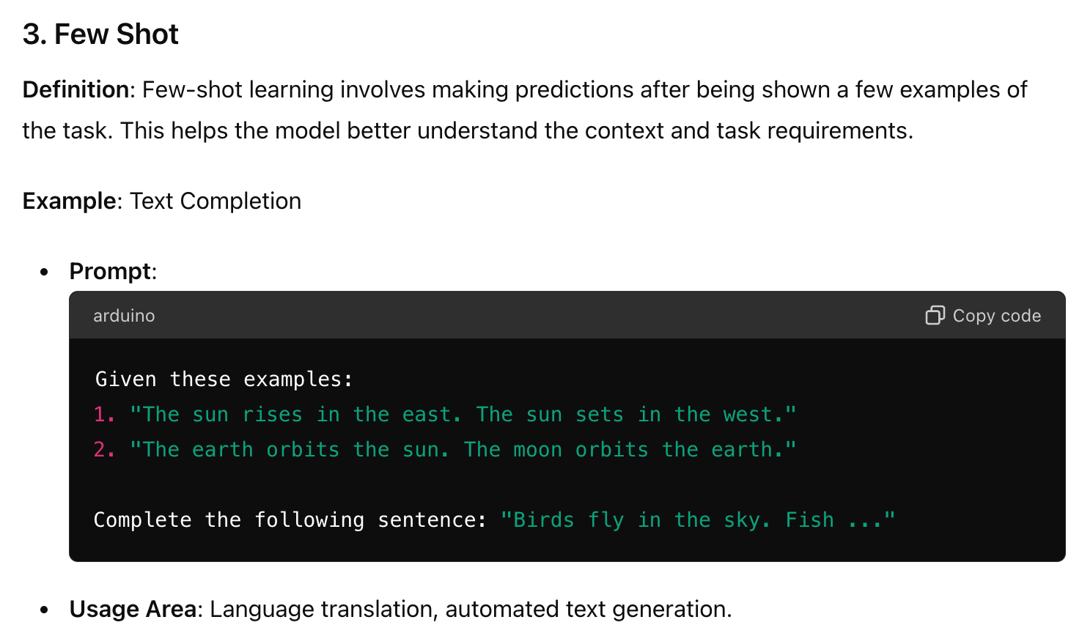

Slide 132
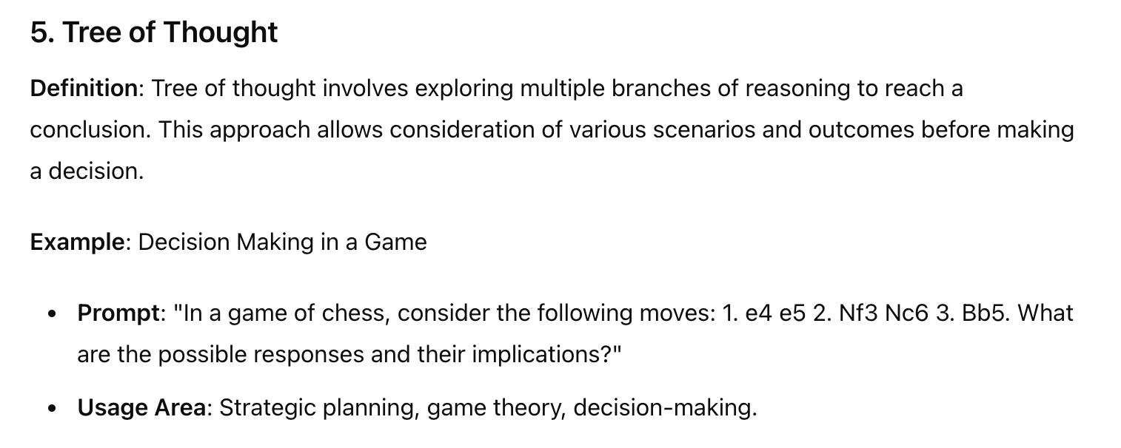

Slide 133
References:
https://www.promptingguide.ai/

Slide 134

Where to start handson

Slide 135
Installation (Python/vscode)
Vscode
https://code.visualstudio.com/docs/setup/setup-overview
Install Java/JRE
Install Python extensions
Virtual env :
python3 -m venv myenv1; source myenv1/bin/activate

Slide 136
LLM resources (OpenAI)
OpenAI:
https://platform.openai.com/docs/quickstart
API keys:
https://platform.openai.com/organization/api-keys
Set env
Create .env and set OPENAI_API_KEY=’your key’
printenv,
export OPENAI_API_KEY=’your key’,
echo $OPENAI_API_KEY

Slide 137
LLM resources (Prompt Engineering)
Sentimental prompts:
https://www.promptingguide.ai/prompts/classification/sentiment

Slide 138
LLM resources (langchain)
Examples:
https://python.langchain.com/v0.2/docs/tutorials/llm_chain/

Slide 139
LLM resources (higgingface)
https://huggingface.co/docs/transformers/v4.15.0/en/examples

Slide 140
LLM
Notes:
https://python.langchain.com/v0.1/docs/integrations/llms/

Slide 141
Large Lang Models are Trained in Public huge datasets like 10TB approx with large GPU machines like 6000 GPUs and cost 2M takes to 12 days to train
Notes:
https://python.langchain.com/v0.1/docs/integrations/llms/

Slide 142
Popular Open Source Datasets for Training LLMs
1. Common Crawl
2. RefinedWeb
3. The Pile
4. C4
5. Starcoder Data
6. BookCorpus
7. ROOTS
8. Wikipedia
9. Red Pajama

Slide 143
Popular LLMs
GPT-4: Best for creating marketing content.
Falcon: Best for a human-like, conversational chatbot.
Llama 2: Best for a free, resource-light, customizable LLM.
Cohere: Best enterprise LLM for building a company-wide search engine.
Gemini: Best for an AI assistant in Google Workspace.
Claude 3: Best for a large context window.
Notes:
https://zapier.com/blog/best-llm/

Slide 144
LLM (open sourced/comercial/closed/community)
Public data sets
Instruct based Datasets
Private datasets(RAG)
Benchmarks
Evaluation Metrics
Notes:
https://python.langchain.com/v0.1/docs/integrations/llms/
https://github.com/Zjh-819/LLMDataHub
https://huggingface.co/spaces/HuggingFaceH4/open_llm_leaderboard
https://kili-technology.com/datasets
https://www.turing.com/resources/understanding-llm-evaluation-and-benchmarks#a.-key-evaluation-metrics
https://www.linkedin.com/pulse/evaluating-large-language-models-llms-standard-set-metrics-biswas-ecjlc/

Slide 145
LLM Architecture
Notes:
https://python.langchain.com/v0.1/docs/integrations/llms/

Slide 146
Parameters
Tokens
Neural networks
Multiple layers
Transformers
Encoder/decoder/encoder-decoder
Activation functions
Attention mechanism
Gradient functions
CNN/RNN
Notes:
https://python.langchain.com/v0.1/docs/integrations/llms/
https://towardsdatascience.com/everything-you-need-to-know-about-activation-functions-in-deep-learning-models-84ba9f82c253

Slide 147
ChatGPT
MetaAI
MS Copilot
Google AI
LLMs

Slide 148
AI ML DL GemAI/LLM Basics
Different types of LLM
LLM Architecture
LLM Frameworks
LLM Stages
LLM Industry Use cases
LLM TUNING
LLM product dev process
LLM Devops
Python Basics
E2E project
Internet Resources

Slide 149
LLM can do below but not limited to
Language Translation
Text Summarization
Content Creation
Sentence auto correction
Sentence auto completion
Sentimental Analysis
Speech to Text
Text to Speech
Image Identifier
Image Classification
Image to Text]Text to image
Fraud detection
Retina identification
Fingerprint authentication
Voice recognition
Article Recommendations
Product Recommendations
Conversational BOT
Medical Dictation
Medical Image processing
Stock Price Prediction
Renewal score predection

Slide 150
SFDC/App
RAG
Vector DB
LLM Architecture
LLM
LLM AGENTS
1
2
Pre Trained
Instruction Trained

Slide 151
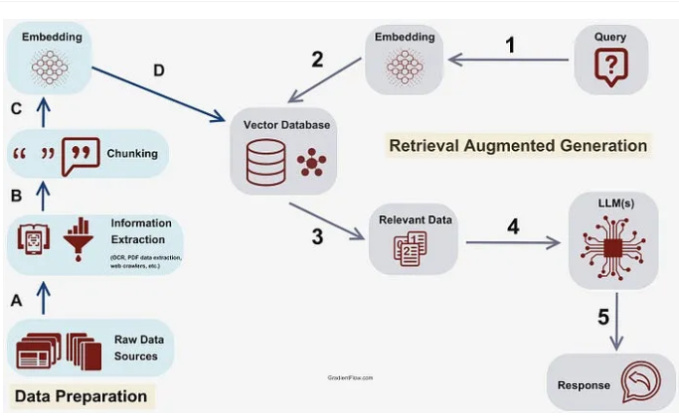
RAG Architecture

Slide 152
LLM AI References
https://www.elastic.co/what-is/large-language-models
https://aws.amazon.com/what-is/large-language-model/
https://en.wikipedia.org/wiki/Large_language_model
https://medium.com/@vipra_singh/building-llm-applications-introduction-part-1-1c90294b155b
https://www.elastic.co/what-is/semantic-search
https://arxiv.org/list/cs.AI/recent

Slide 153
empty

Slide 154
OpenAI
Notes:
https://python.langchain.com/v0.1/docs/integrations/llms/

Slide 155
OpenAI MODELS
MODELS LIST : https://platform.openai.com/docs/models/gpt-4-turbo-and-gpt-4
MODEL PARAMETERS
model=GPT_MODEL,
temperature=0,
max_tokens=200,
top_p=0.5,
n=1,
stop="Translate:",
frequency_penalty=0.6,
presence_penalty=0.8,
REF: https://medium.com/@csakash03/model-parameters-in-openai-api-fe6101d3f813
MODEL PROMPTS:
https://platform.openai.com/docs/examples
Notes:
https://zapier.com/blog/best-llm/

Slide 156
Customer Conversation
Customer reached out support and chatted with agent and at the end of chat or phone call LLM will summarize the results to have follow up actions
LLM reads the case record/email/chat/task- and
LLM determines sentiment of customer
LLM determines sentiment of customer and provides why it is so
LLM summarizes an apology/thank you note to customer
LLM escalates to manager to seem extra help to improve customer satisfaction

Slide 157


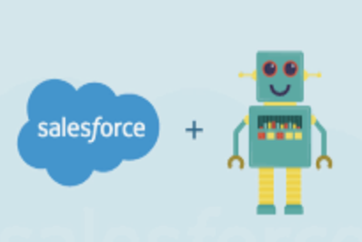

Architecture
Customer chats
Llm request
cases/
leads/
accounts/quotes
LLM Prompts
Customer Emails
Llm response

Slide 158
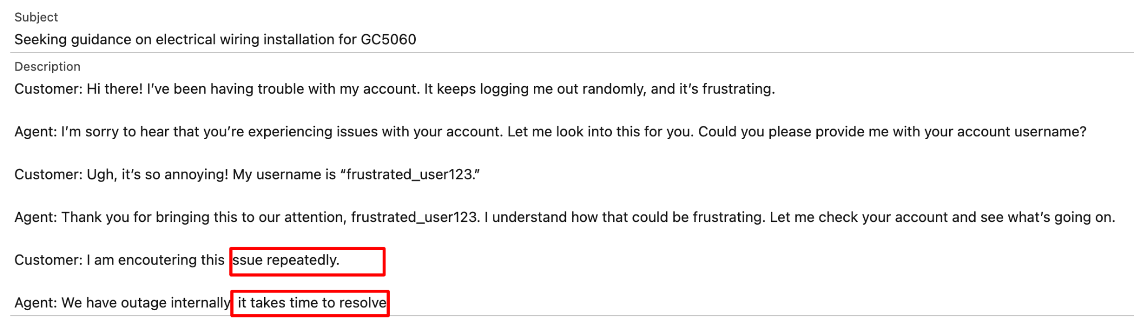
For Example a Conversation like : (negative sentiment)

Slide 159
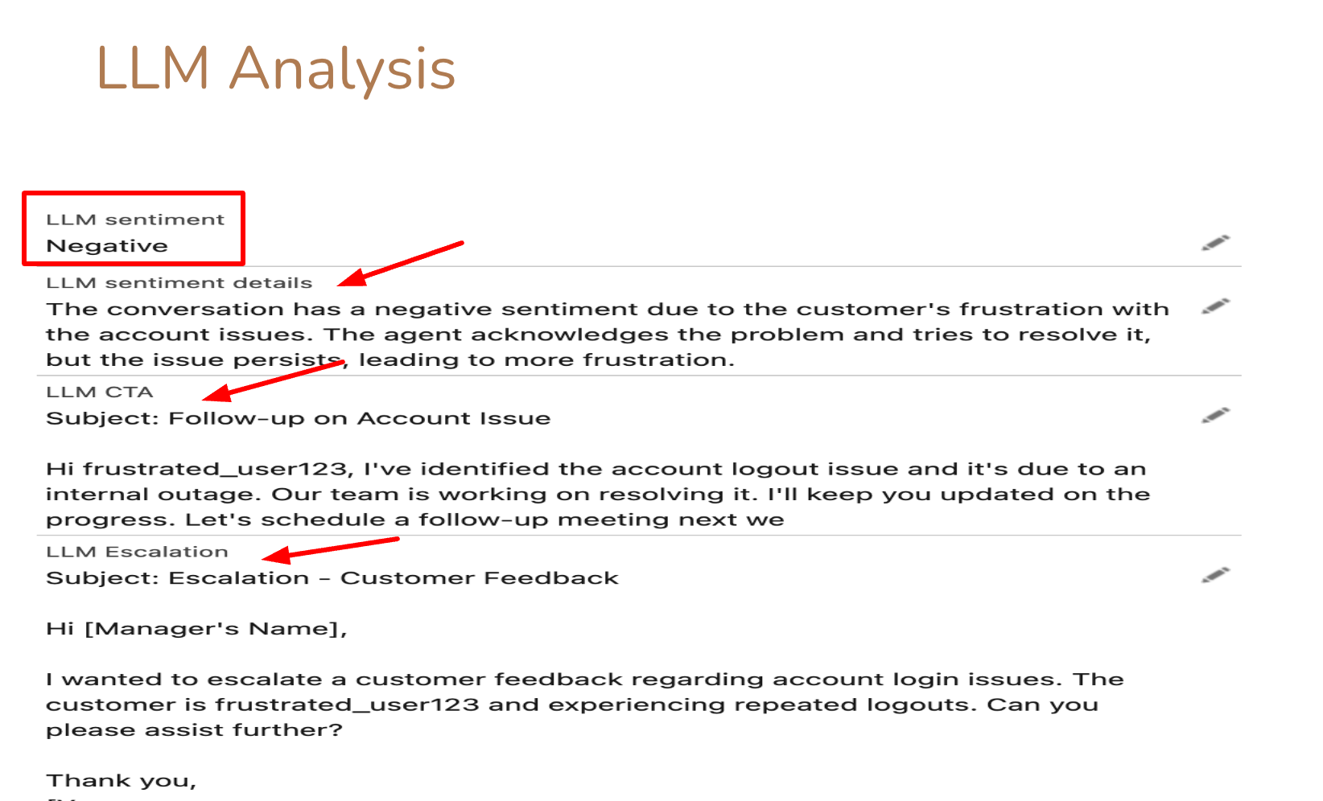
Now llm looked at record and provided the below

Slide 160
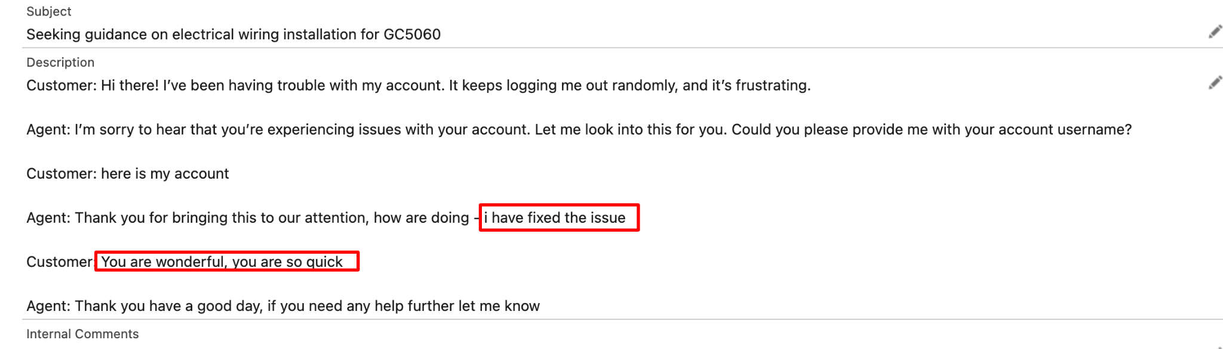
For Example a Conversation like : (postive sentiment)

Slide 161
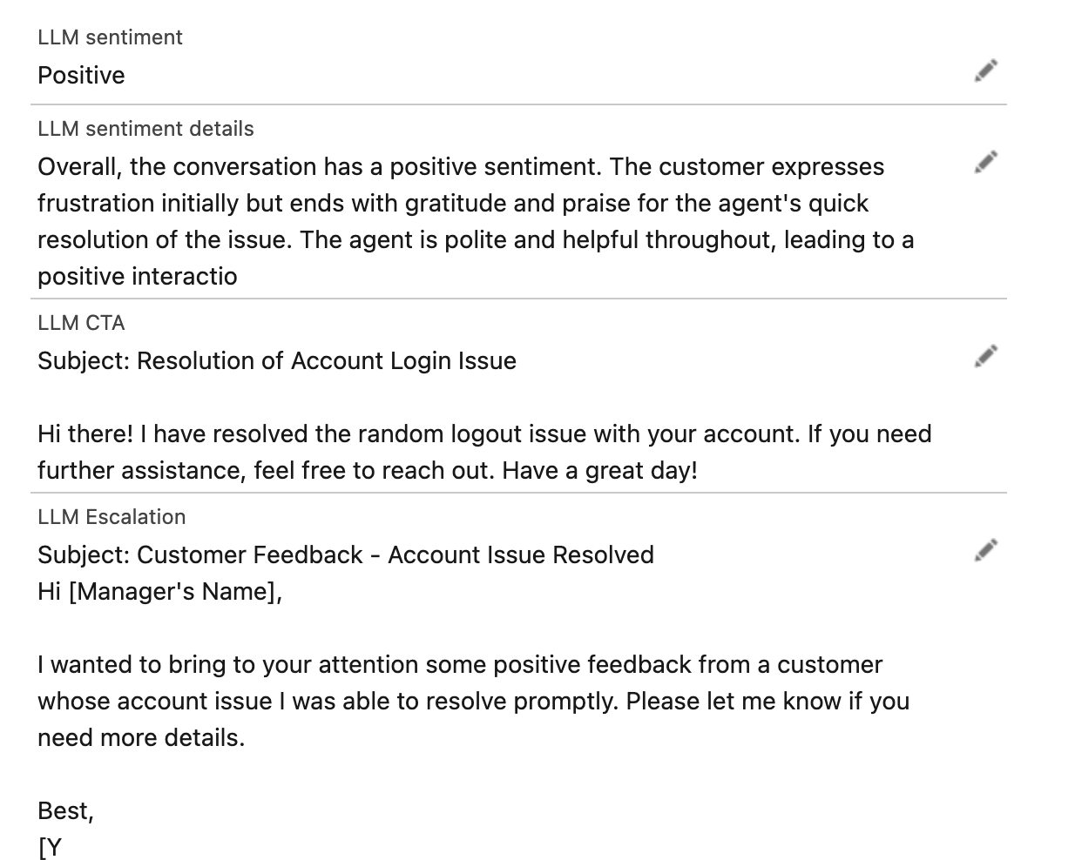
LLM Analysis

Slide 162
Additional open AI LLM use cases in CRM world

Slide 163
Additional use cases -set1
Phone call Call summary
Email summary
Record summary
Task summary
Case Description summary
Auto response based on case context
Chat and Case Routing by classification

Slide 164
Additional use cases -set2
Health score calculation
Churn rate identification
Opportunity Forecast analysis
Lead qualification summary
Lead marketing emails followup
Agents Training
Agent auto reply recommendations

Slide 165
Additional use cases -set3
Task,Activities,Meeting summary
Quote record summary
Usage consumption summary and early renewal alert
Customer feedback analysis
Opportunity bottlenecks
Service record summary
Customer Monthly interaction analysis
Product recommendations Helper

Slide 166
Sample open AI Code in repo
Category | Github link | Description/Purpose
Text Classification | Code | This code will take customer chat/question and it automatically classify the intent and return classification criteria - very useful for agent transfers-we can plugin to any CRM or IVR
Text Summarization
Chat Sentiments
Voice Call Summary
Meeting Min summary

Slide 167
Sample open AI Code in repo
Category | Github link | Description/Purpose
Post Chat Summary & Follow up
Post Voice Call Summary

Slide 168
EXTRA SLIDES
Notes:
https://app.dataquest.io/c/168/m/895/introduction-to-ai-chatbots-with-chandra/4/machine-learning?path=30&slug=generative-ai-fundamentals-skill&version=1
https://www.w3schools.com/python/trypython.asp?filename=demo_default

Slide 169
Training Community Rules
Respect others
This meeting is recorded.
Mute Yourselves always
Chat your question first
Do not chat with other candidates
Do not steal other candidate info(ph number/email etc)

